Slide 1
Always Advancing Pervious
Pervious challenges:
Build tougher pavement.
Build pavement that drains well.
Notes:
We can identify the challenge of building pervious concrete pavement that is more durable and will drain well. Our design and construction methods can advance mixtures and finishing methods. Our systems can be designed to be maintenance friendly by observing the specific unique functions of pervious concrete pavement in the practice of storm water management.

Slide 2
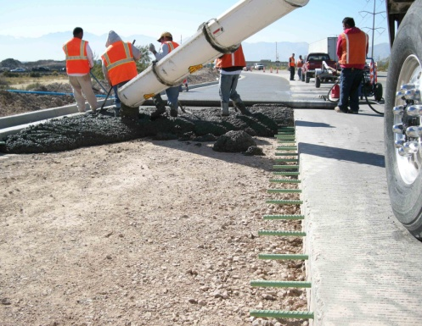
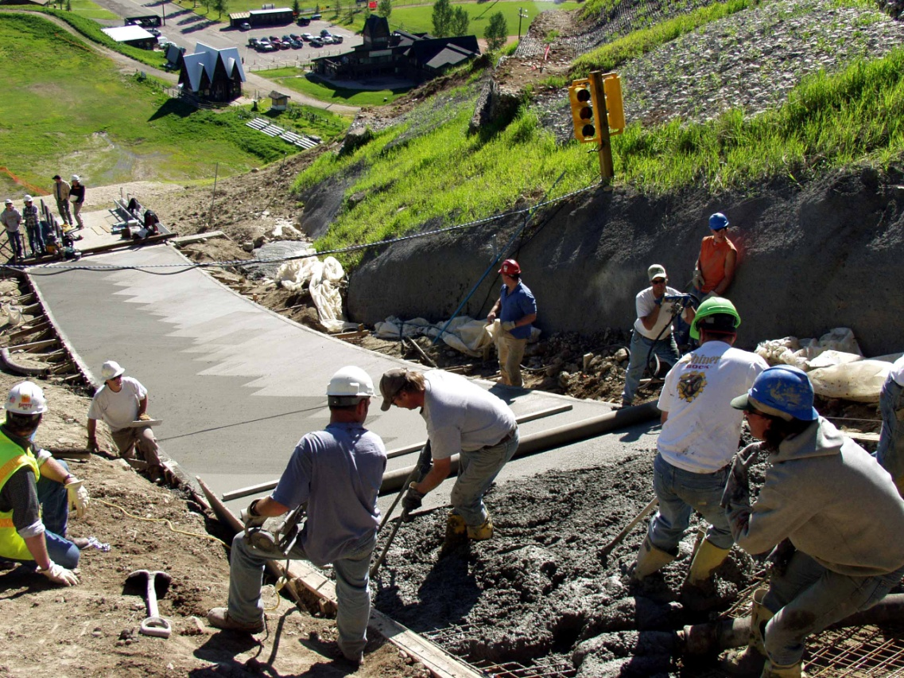
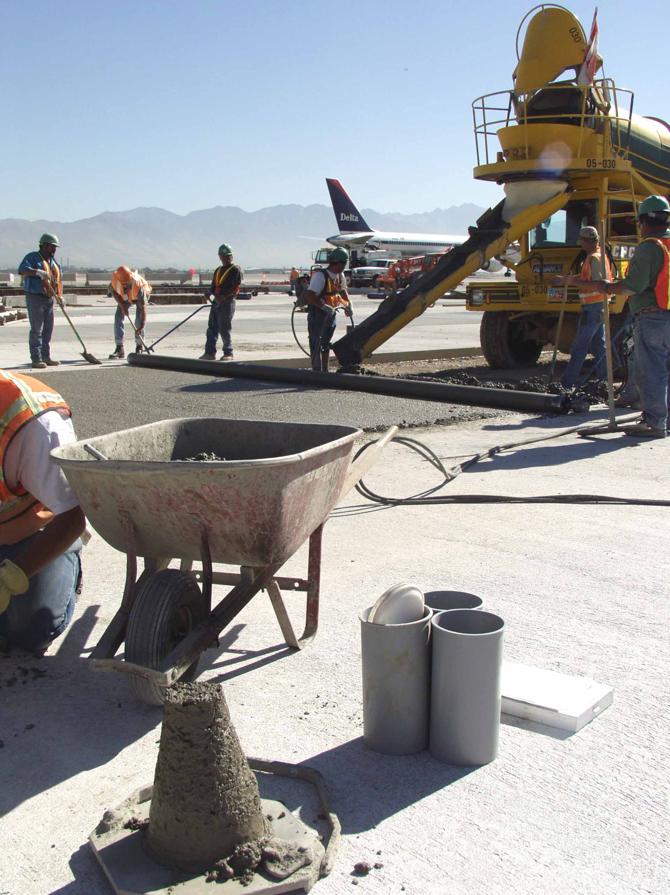
intro
David Mitchell
Bunyan Industries
Equipment manufacturer
Allied with NRMCA and promoters of cement and ready mixed concrete
Notes:
Greetings, I'm David Mitchell from Bunyan Industries, a company that manufactures equipment for concrete flatwork. Much of our work is an effort to help contractors build some of the most challenging flatwork like steep slopes and the irregular pieces of highway pavement.

Slide 3
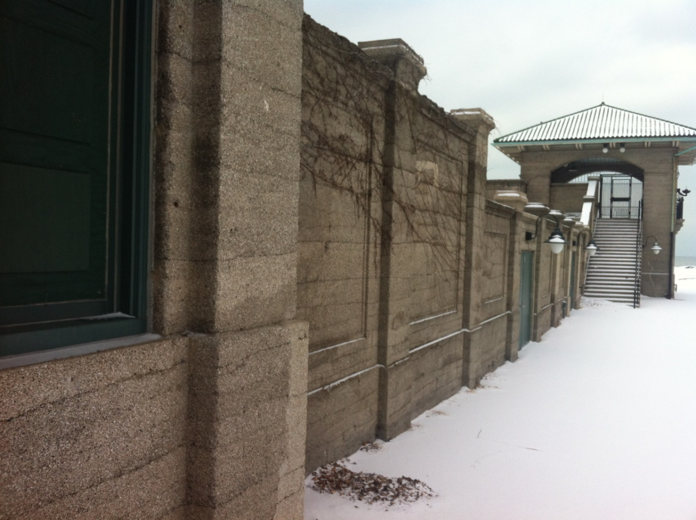
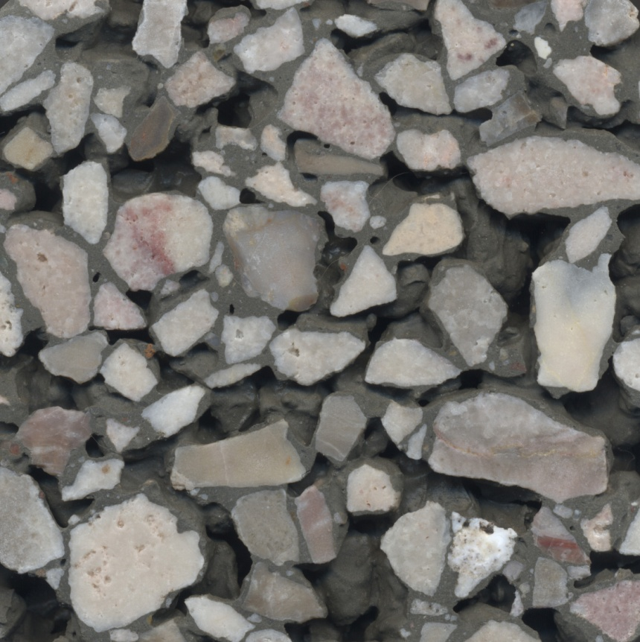
No Fines
Insulation properties
Permeable sub-base
Pavement of the future.
Notes:
I first noticed pervious in a magazine story about the mixture being used for insulation properties, where it was cast in wall forms. I first held it in my hands when a man brought a small puck to our exhibit at World of Concrete in 1988. It struck me as some sort of structural malfunction as flatwork goes but the guy described it as the pavement of the future.

Slide 4
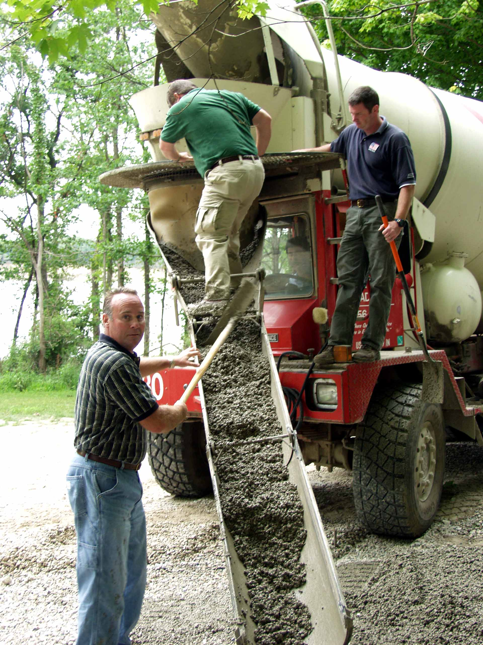
Emerging markets
Dry?
Freezing?
Notes:
I was approached by some rednecks from Indiana twelve years ago as they were trying to bring this pavement into markets with freezing conditions. At the same time, others were trying to use it in the western US, where dry climates proved unsuitable for mixtures that worked okay in Florida. Those who promoted and built pervious concrete pavement systems in the early days have been plagued by the failures of heavy, dry mixtures in dry and freezing climates.

Slide 5
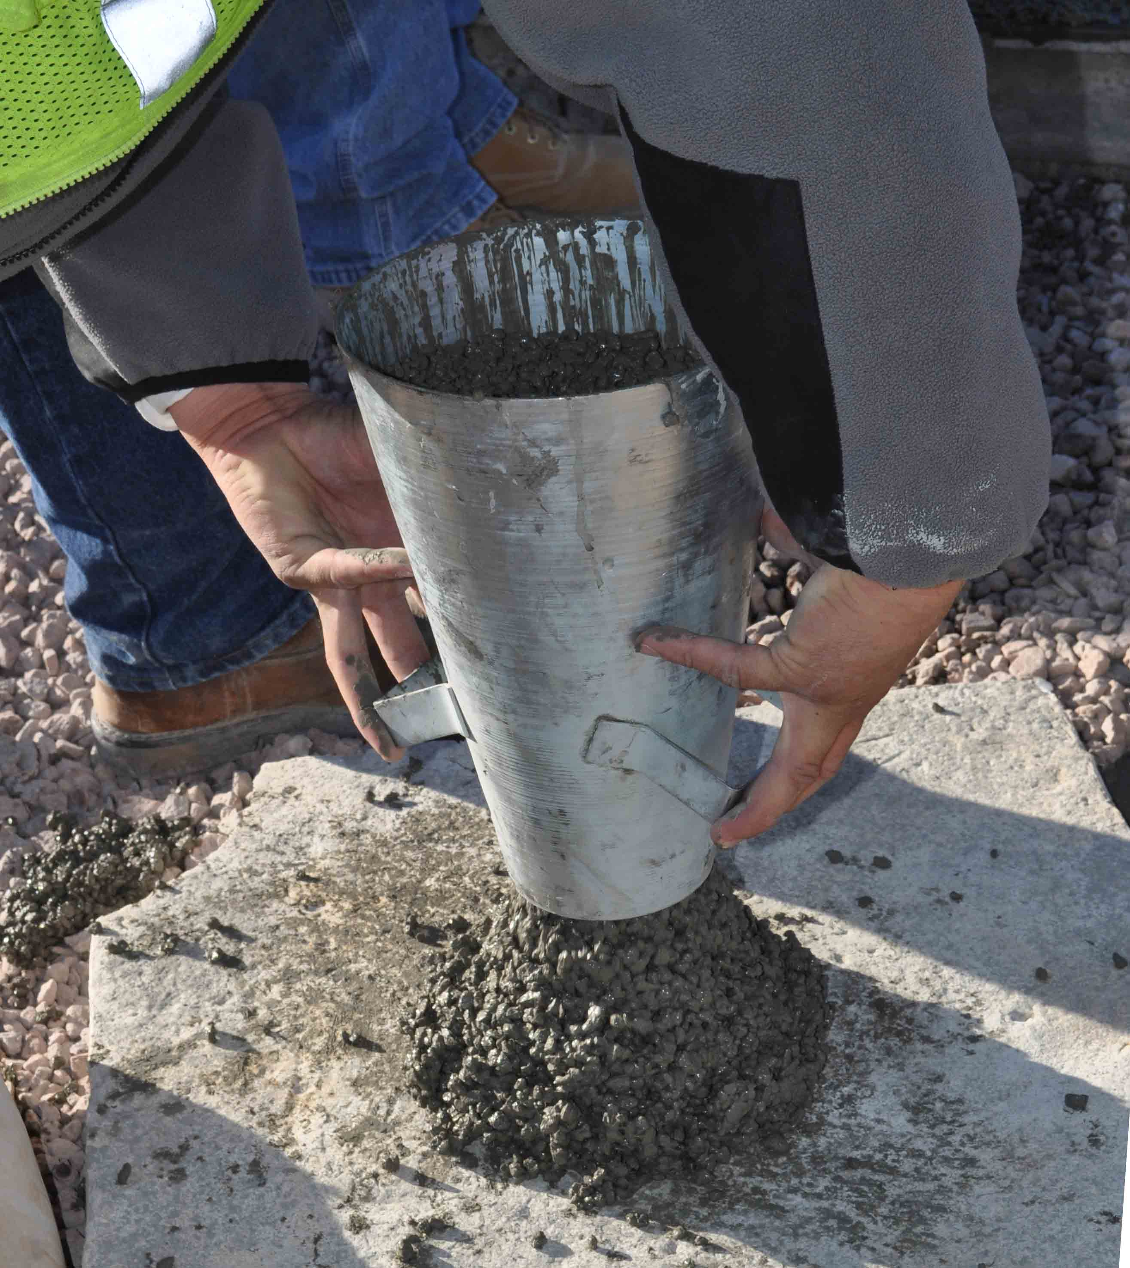
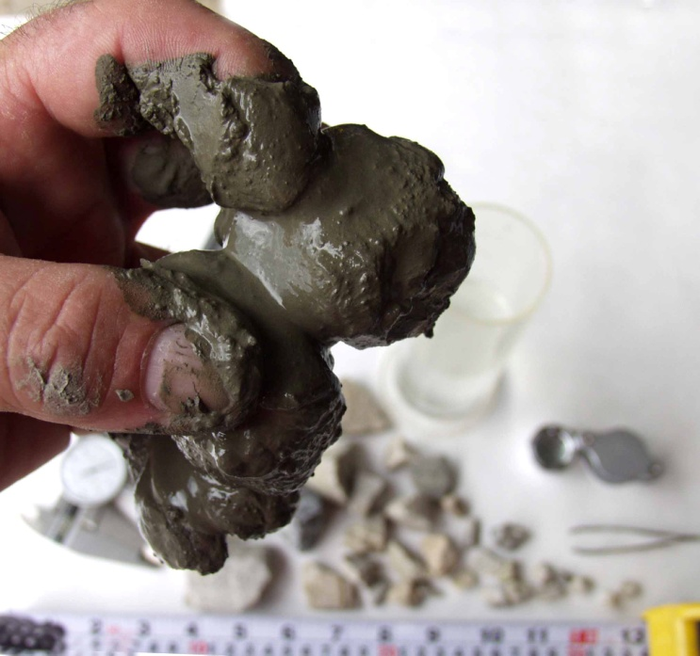
Modern pervious concrete
Lighter= 410 – 520 pounds per cubic yard
Wetter = .32 - .34 water / cement ratio
Flowable = priceless
Notes:
I joined that group from Indiana as we began to transform the pervious mixture into a lighter, wetter, and more flowable mixture. This required us to preach against the accepted practices of proportioning the pervious mixture the same as conventional concrete. This reversal becomes apparent when the producer is told to reduce the proportion of cementitious powder in order to make room for increased water content. The pervious concrete mixtures were designed with between 630 to 720 pounds of powder, whereas modern pervious mixtures are now using between 410 and 520 pounds of powder. Great resistance and objections would arise from the presumption that this was an effort to economize the mixture. Not so! We would be fully prepared to load up more powder if that's what made it work.

Slide 6
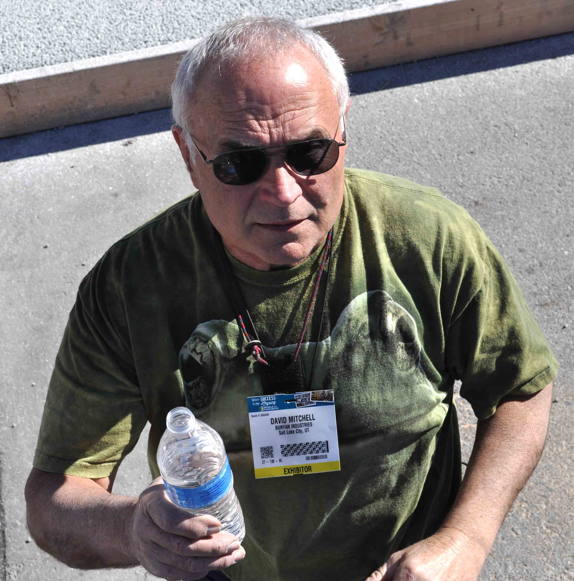
More?
.
Notes:
People came to realize that the main problem with heavy mixtures is a shortage of water. Where I come from, real men are judged by their water/cement ratio. Friends don't let friends add water and the worst crimes in concrete occur with added water. One must understand that pervious concrete is made from a very different type of water.

Slide 7
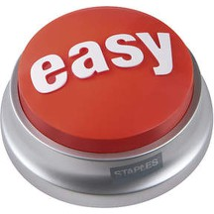
Water of convenience
.
Notes:
When water is added to a conventional concrete mixture to aid an easier placement, it's called water of convenience.

Slide 8
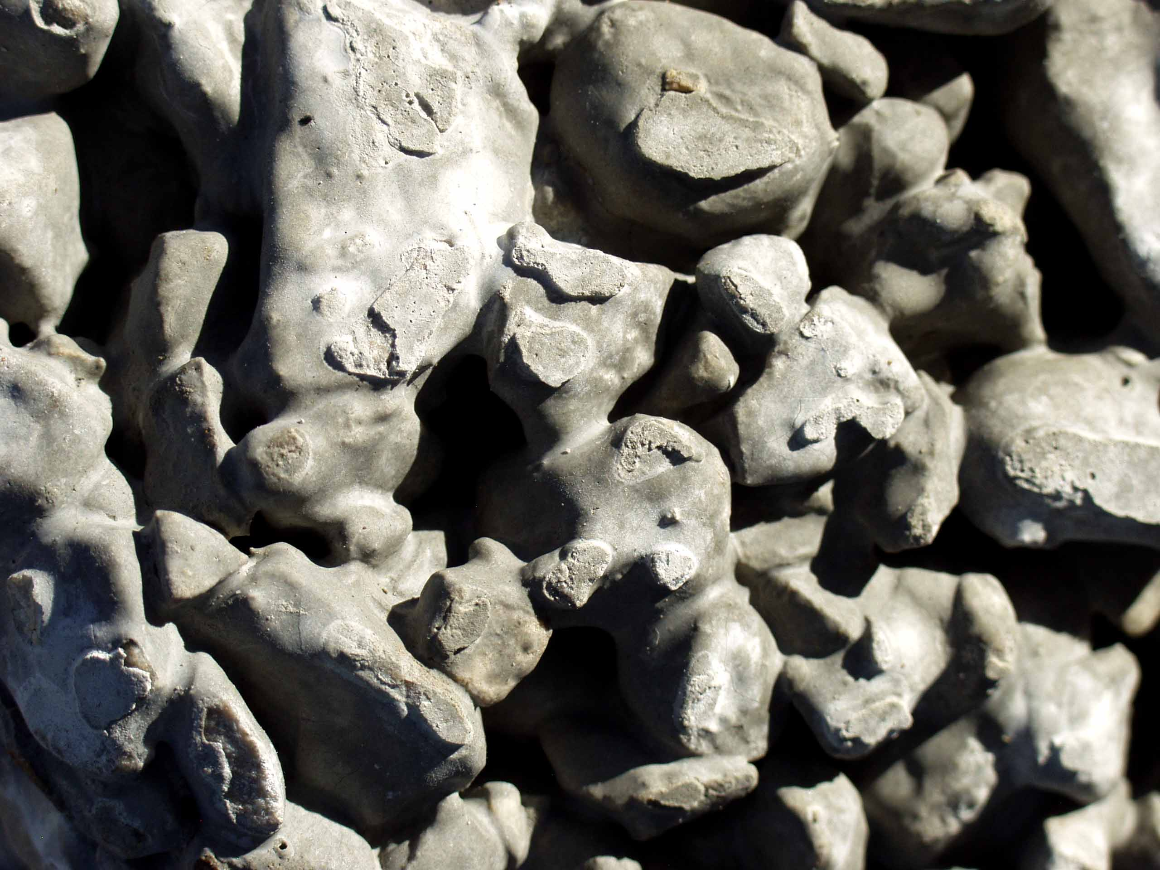
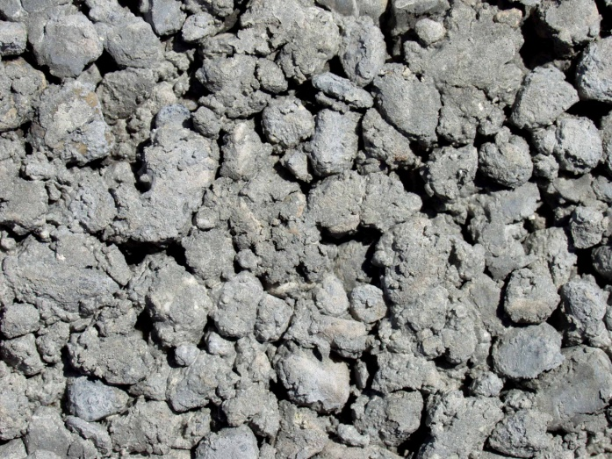
Water of Necessity
Chemistry
Paste Coating
Paste Bridge
Lubricity
…or starved.
Notes:
. However, if only half that much water is added to:
Supply the chemistry,
Shape the paste bridge between aggregate,
Bring a certain lubricity to the paste,
We think of it as water of necessity. The essential water content cannot be reached in the pervious mixture without observing the limits of proportion between paste and aggregate. Otherwise the mixture is starved for water or it's no longer pervious.

Slide 9
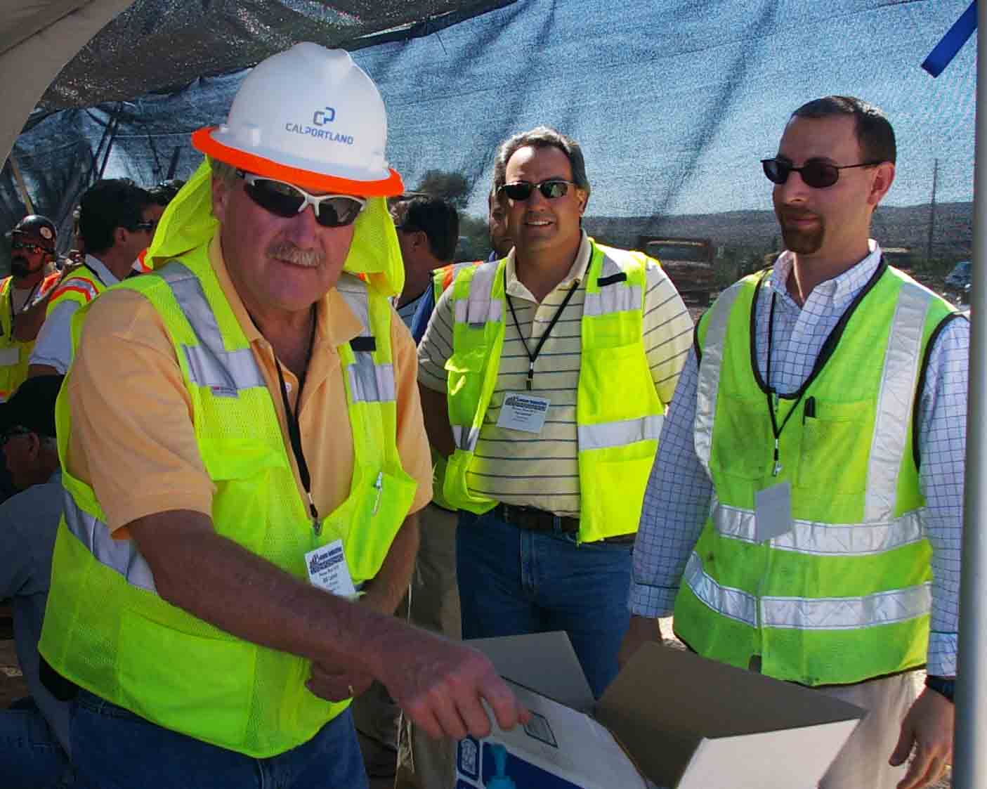
2009
The new age of Modern Pervious.
Notes:
NRMCA and ACI formally recognized these lighter and wetter mixtures for pervious concrete in 2009 and I thought this meant that our troubles were over. I organized a group of industry professionals who joined the efforts of the original rednecks to help bring pervious concrete to its rightful place among the choices of marketable pavement products.

Slide 10
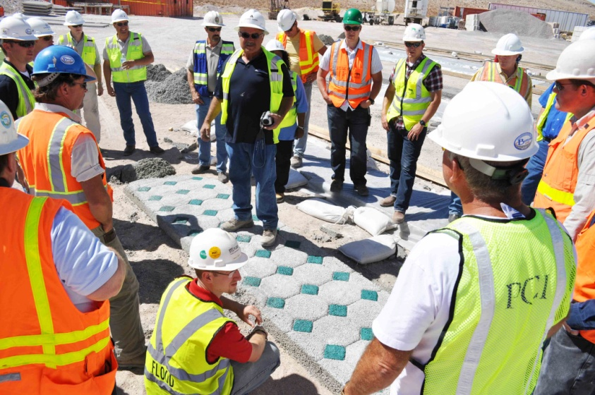
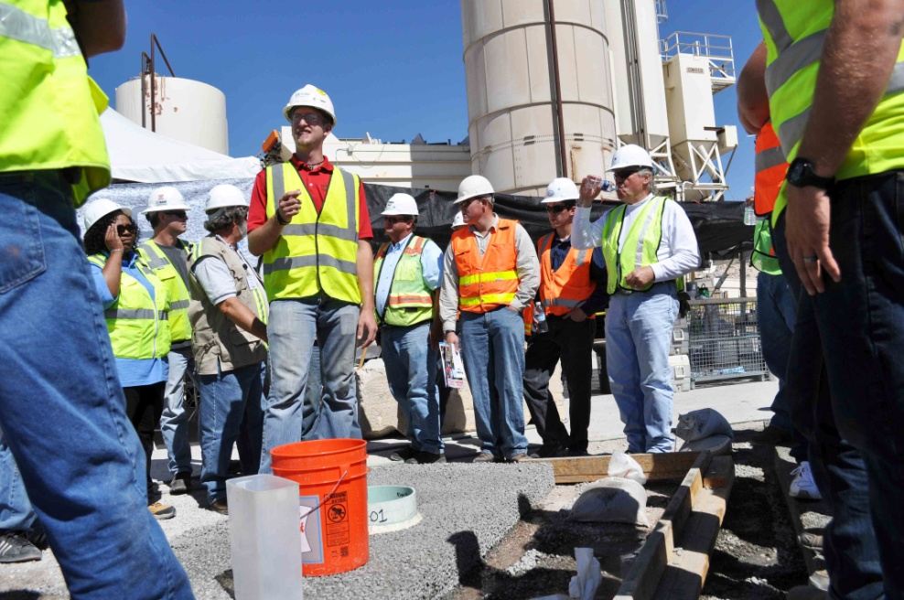
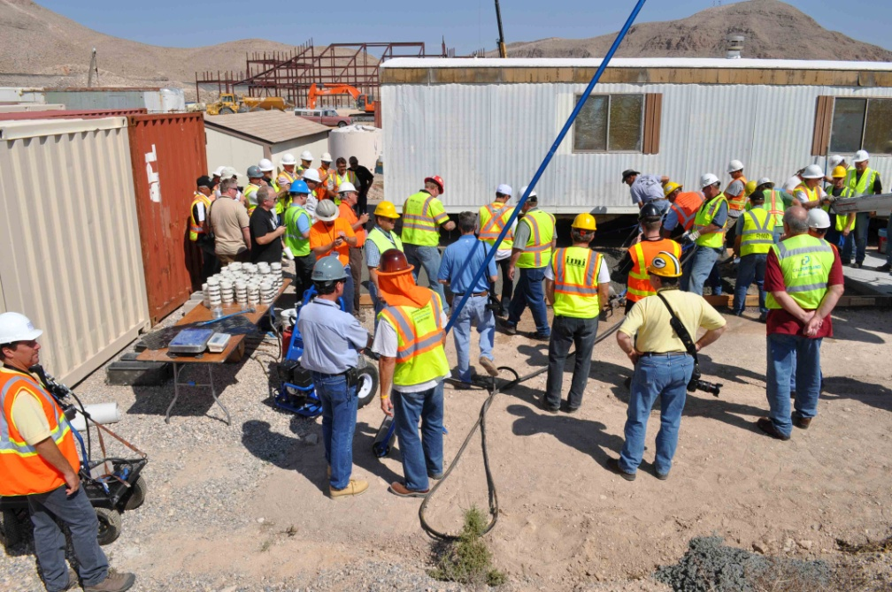
Perv camp
Bunyan Pervious Roast, 2010
Notes:
We attracted the efforts and the best ideas for solutions with problematic mixtures in the most challenging conditions. The relative humidity and ambient temperature in Vegas proved challenging as solutions are shared to the industry. This discovery effort continues.

Slide 11
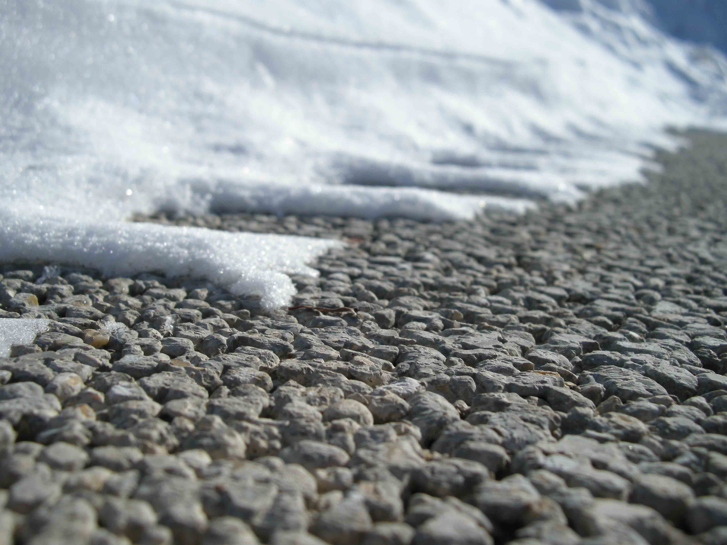
Freeze resistant
Wet, metallic sheen.
Well formed paste.
Particle packed.
Check
Check
Check
Notes:
The modern pervious concrete mixtures have a well formed paste which will absorb less storm water during service. The paste coating has a uniform shape which also helps to protect the aggregate from deicing salts that could be absorbed. Higher density in the paste will allow brine to pass through the interconnected voids with continued flow of storm water. Our work with silica fume in pervious mixtures proved to be another effective measure against the absorption of brine. The properties of modern pervious came to be tested when high performance deicing salts were used in excess.

Slide 12
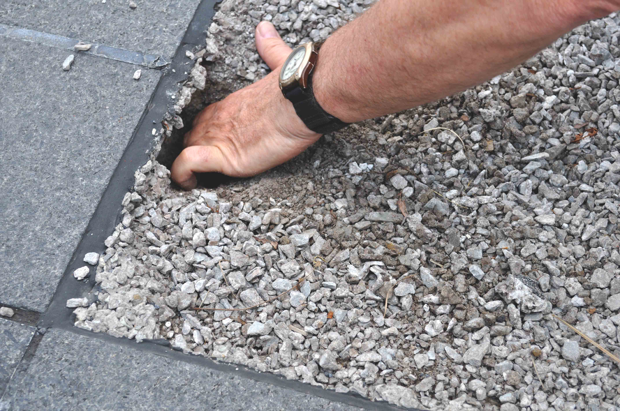
Salt Belt, 2013-14
High Performance Deicing Products in Action
Notes:
However, the winter of 2013-14 showed a devastating scenario with wet storms and cold temperature in a prolonged winter across Illinois, Ohio, Pennsylvania, and Maryland. As we witnessed these conditions, we also saw certain patterns in the marketing and distribution of deicing products. Some cases were found to have completely disintegrated the entire slab section where high performance salts were used.

Slide 13
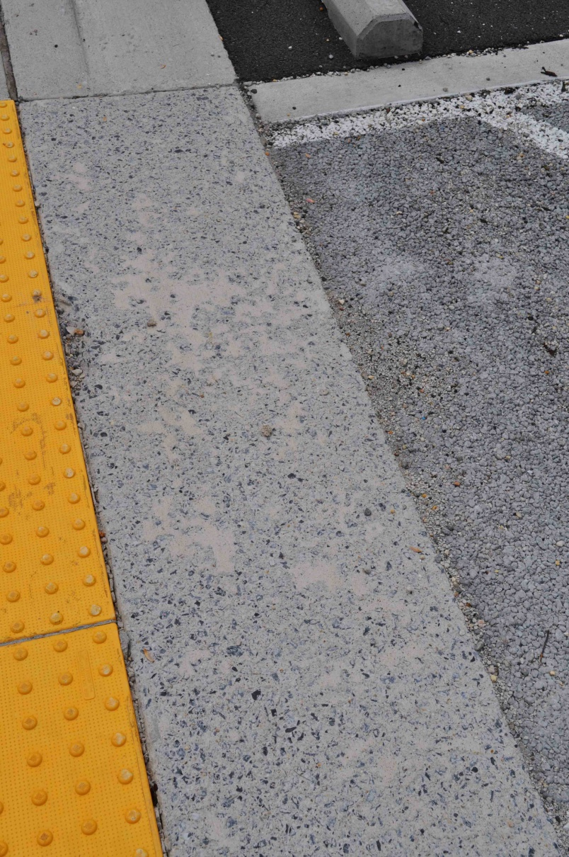
Salt Belt, 2013-14
High Performance Deicing Products in Action
Notes:
Conventional pavement will flush salts from the surface as continued precipitation dilutes them and carries this into the urban watershed, along with the rest of the urban drool. If salt damage occurs on conventional concrete pavement, it usually strips the surface with light spalling.

Slide 14
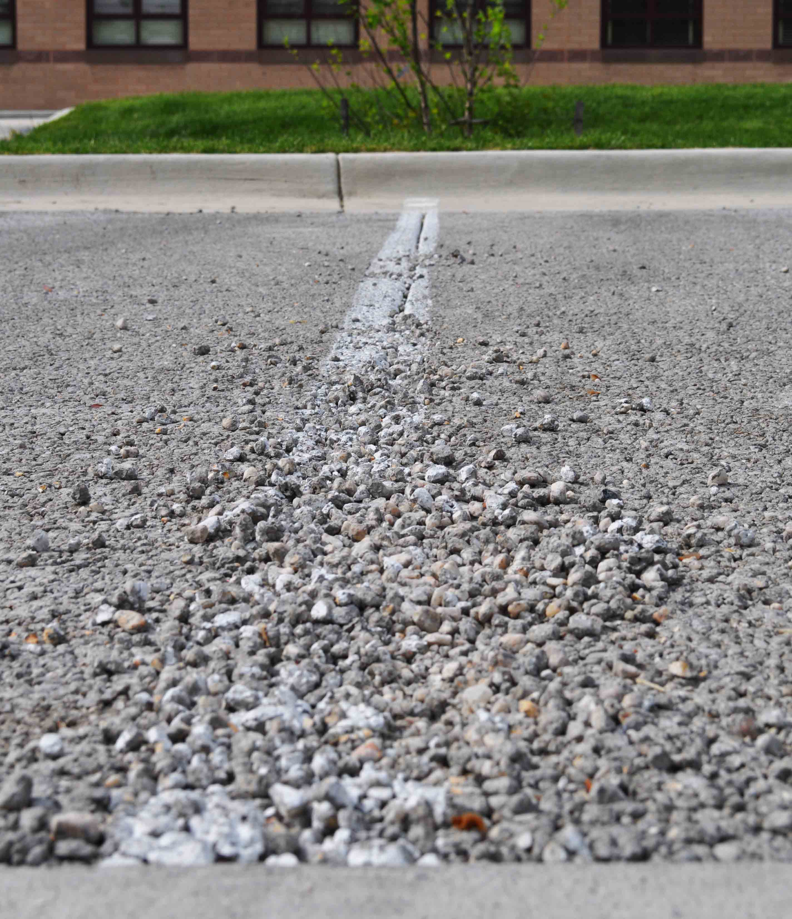
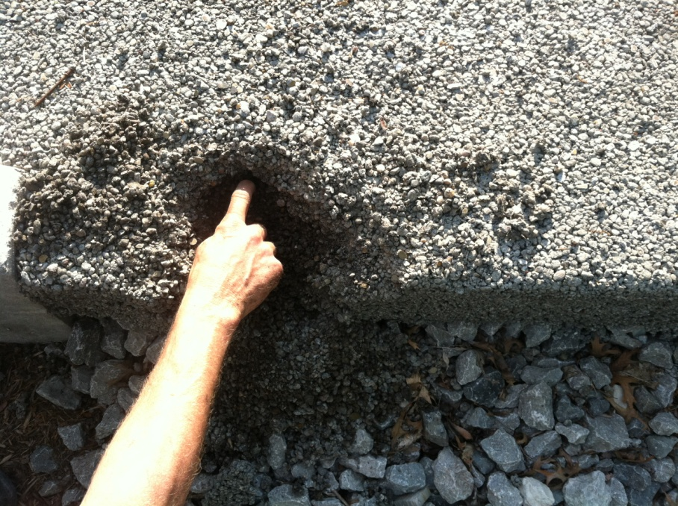
Salt Belt, 2013-14
High Performance Deicing Products in Action
Notes:
A very different process is underway in pervious system. The salts enter the slab section and the detention basins under the pavement. Evaporation occurs and causes the salt crystals to reform inside the pervious voids. The matrix of the pervious slab is filled with voids, each with a certain surface area. When this surface is attacked, it happens throughout the entire void structure. This alarming aspect of vulnerability in pervious concrete should be clearly understood by those who promote this pavement and those who own it. That's aside of the challenges to those who build it.

Slide 15
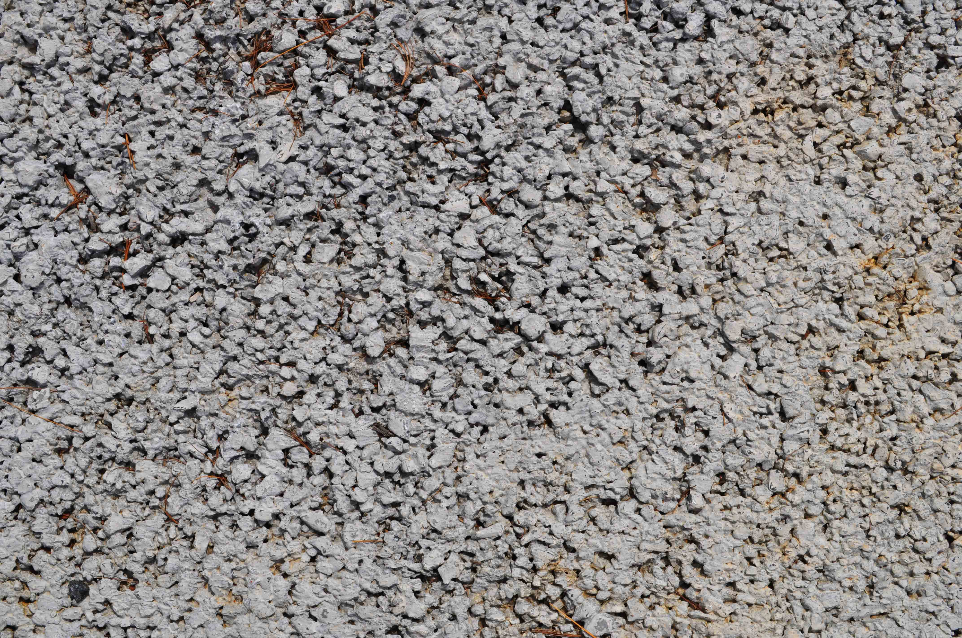
Salt Belt, 2013-14
Salt free.
Notes:
Those who design these mixtures must understand this vulnerability and where it applies. We should ultimately consider the function of the pavement in service and the likelihood of it being salted. It's not about freezing the pavement so much as the salting. Don't worry about the baseball facility or the boat house. Don't worry about the Chinese Christian Church, because they believe it's some kind of goof to salt the earth for any reason. I concur.

Slide 16
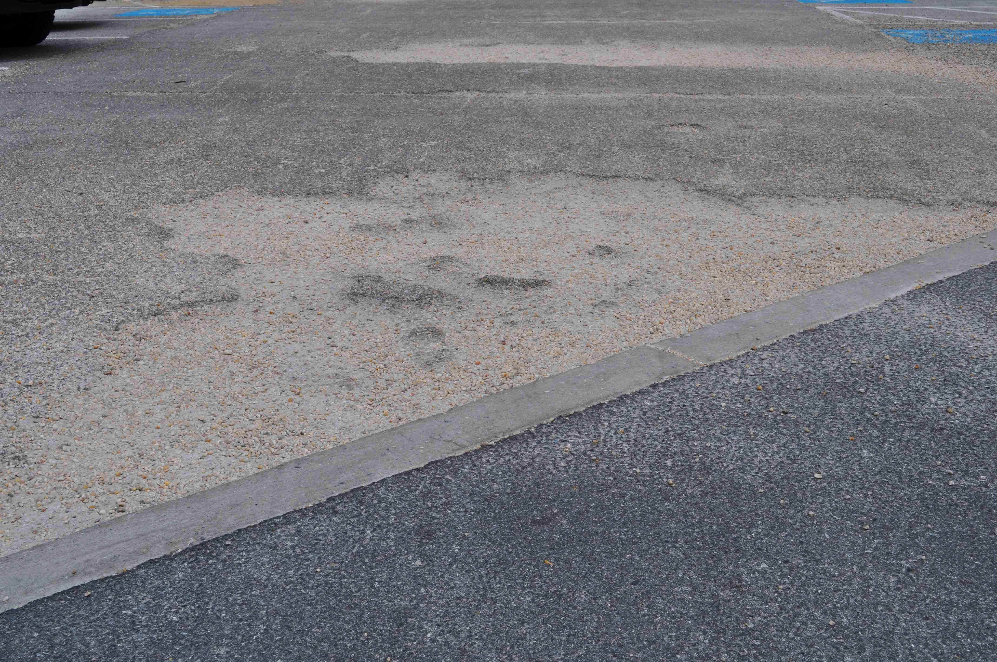
Salt Belt, 2013-14
Pervious Carnage
Notes:
We are a little nervous about what migrates into our parking area from the highway being tracked in by vehicles. We can build this pavement to resist this degree of contamination. However, we don't stand a chance against the snow removal contractor who scoops out high performance salts to make his task easier. We don't stand a chance when an owner thinks this makes him legally defendable. The handicap parking, the visitor's parking, and the unloading zone are the first to be blown to pieces. The VA hospital in Pittsburg has a pedestrian plaza that was destroyed in one season.

Slide 17
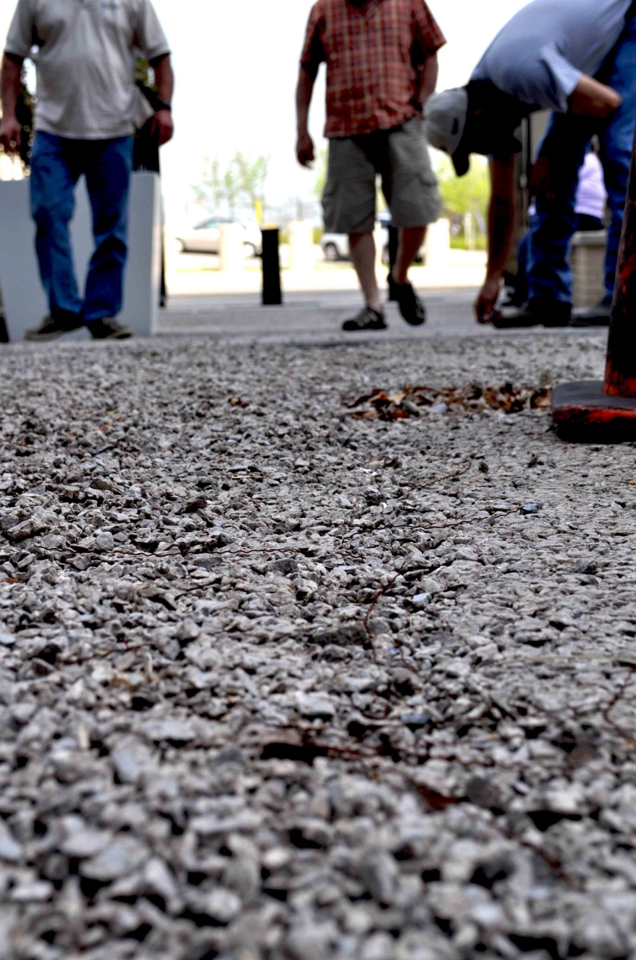
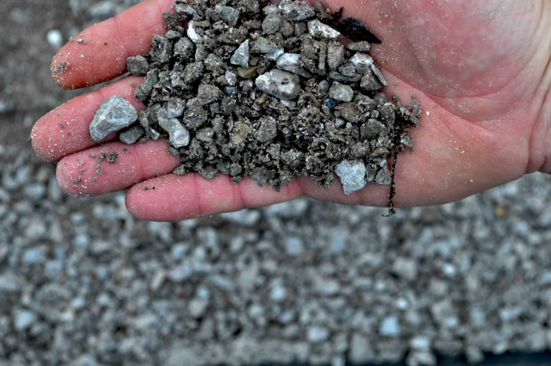
Salt Belt, 2013-14
Pervious Carnage
Notes:
I don't want to hurt anyone's feelings but pervious is not paradise, although it can be. For many, pervious is a nightmare because of the unique and unusual ways that failure occurs.

Slide 18
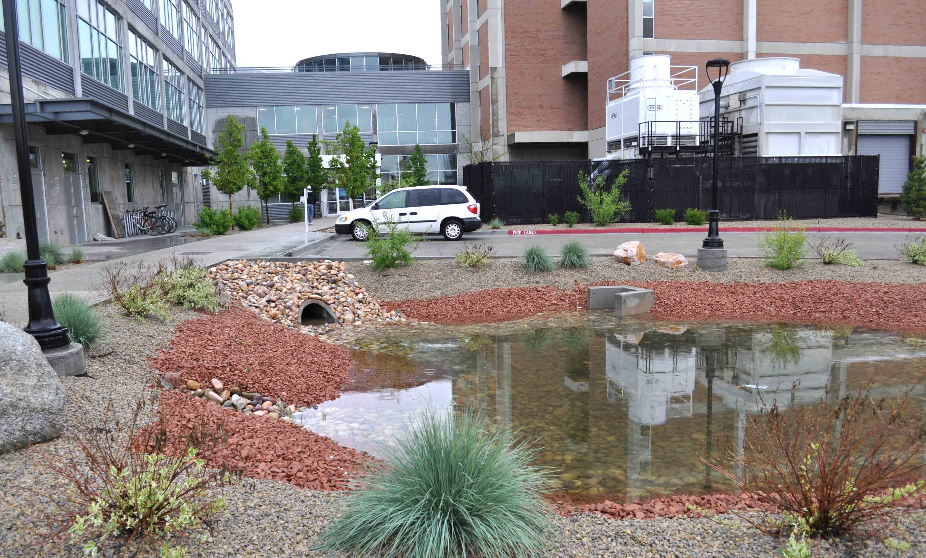
Generic Pervious
Off the shelf
Cost effective
Baseline
Notes:
We consider the base line for a pervious mixture to be available at almost any ready mix producer from components that are "off the shelf" among his routine operation and we call it "Generic Pervious". With all of the components dialed in at 20% voids, it contains nothing more than a little sedative to keep it from going off before we're finished. Generic Pervious is our strongest contender in cost effective answers for both storm water and pavement. In teaching both contractors and producers, Generic Pervious must be clearly understood before trying any "value added" components for enhanced features. As we consider the benefit of value added components, we base our evaluation of potential resistance to freezing brine.

Slide 19
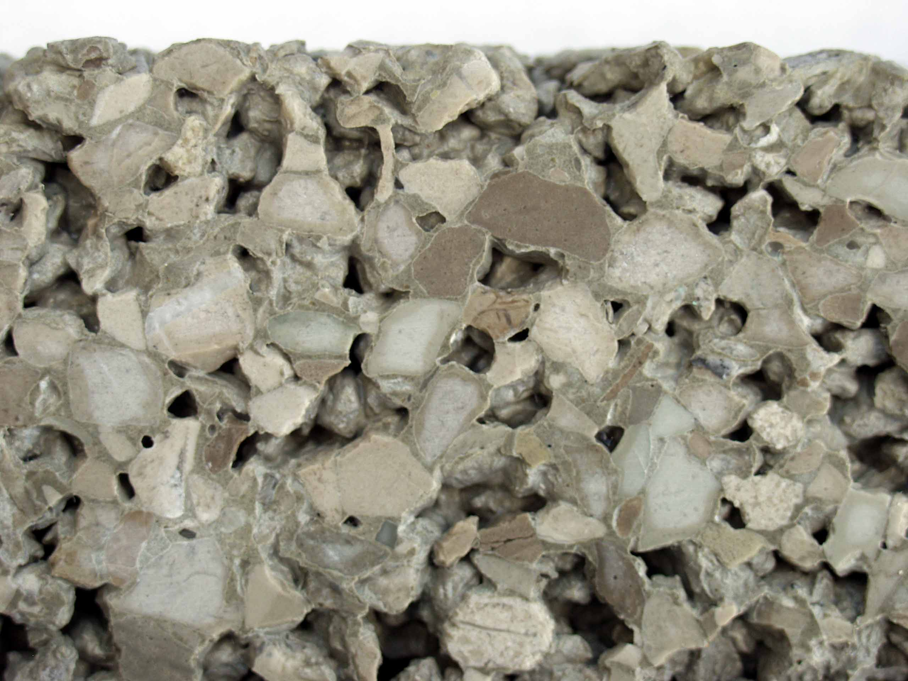
Generic Pervious
Proportioned at 20% voids
Wet, metallic sheen
Well formed Paste
Easily reformed Paste
Hydration Stabilizer
Notes:
We have found the most success in this by first, establishing the paste coating of proper consistency by properly targeting paste volume and moisture. The wet metallic sheen is reference to surface tension on the paste.

Slide 20
Air? Or, not to air?
Intended purpose?
What generates air?
What maintains air?
Compromised density?
Notes:
Most of our group agree that entrained air does not serve the intended purpose in a pervious mixture because of the presence of the void structure. Entrained air is generated and maintained by certain sizes of aggregate that are not usually present in a pervious mixture. More importantly, the entrained paste is more absorbent and goes against our ambitions to use particle packing within the paste component. The Generic Pervious mixture is affordable, somewhere near the same as a conventional mixture from the same source.

Slide 21
Value added pervious, top three components.
Mix Water Conditioner
Silica Fume @ 5%
Structural Fibers @ 5 lb.
Notes:
If we are able to increase the price of our "value added" mixture by roughly 50%, I believe that the greatest benefit would be had from three components.
Mix Water Conditioner makes the water do a better job connecting with the cement.
Silica Fume included as 5% of total powder.
Structural Fibers at 5 pounds per cu. yd.
Seventeen other products could be considered as enhancement of the pervious mixture but not all of them should be included if deicing salt is on the menu. Many great products are available to inhibit evaporation, hold moisture, densify the paste, and extend the placement window. These clearly make the pavement more valuable and we continue to describe the features of each, in plain language.

Slide 22
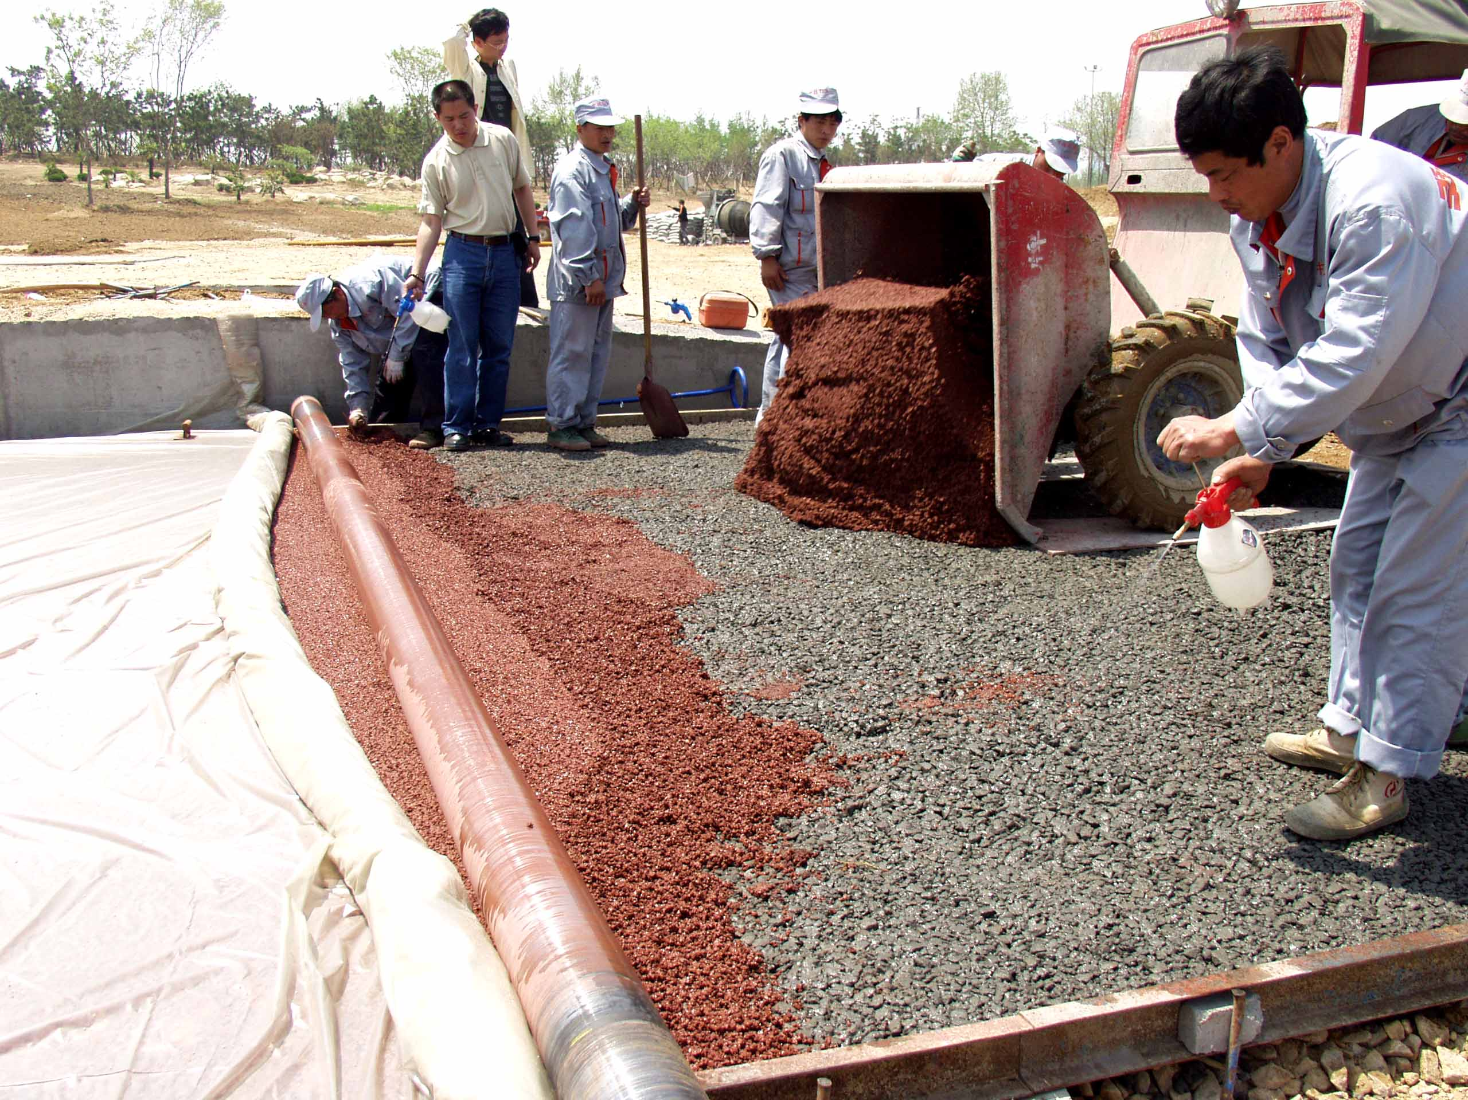
Innovations
Multi-Layered Pervious
Notes:
A very bold innovator in our group is Lizhong Wang, who made great progress with multi-layered, fresh on fresh, concurrent placement method of both structural and decorative pervious concrete mixtures. During the sessions of our think tank in 2011, Mr. Wang introduced the motorized pan float in replacement of the cross roller. Along with special rules for panning a pervious slab, the mixture must be light and moist to respond properly to the motorized pan float.

Slide 23
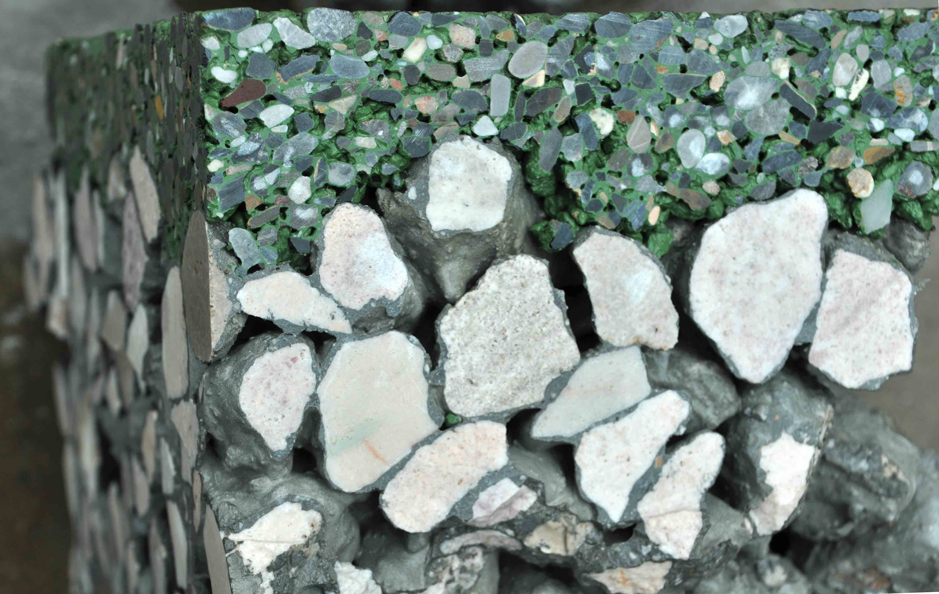
Innovations
2011 Bunyan Pervious Roast
Notes:
Pavement section from the 2011 Bunyan Pervious Roast

Slide 24
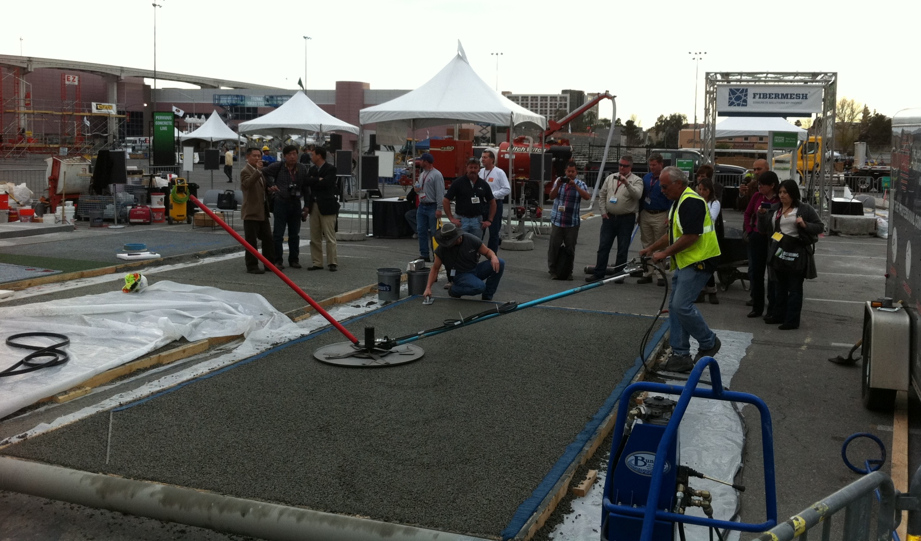
Innovations
Pan Floating Pervious at
World of Concrete, Pervious Live 2012
Notes:
During World of Concrete 2012 we introduced our own version of a low-impact motorized pan, when the pervious industry took a giant step forward. Soon, many industry professionals were reporting increased durability, flatness and uniformity from the use of a motorized pan in various configurations.

Slide 25
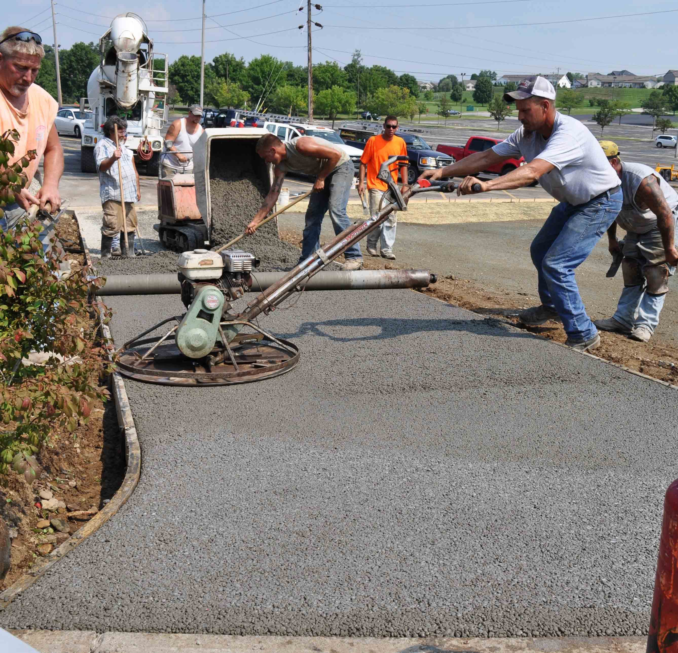
Innovations
Pan Floating Pervious with
Conventional pan configuration
Notes:
Most of the pervious mixtures being used will tolerate a conventional trowel machine, fitted with a pan, with great results.

Slide 26
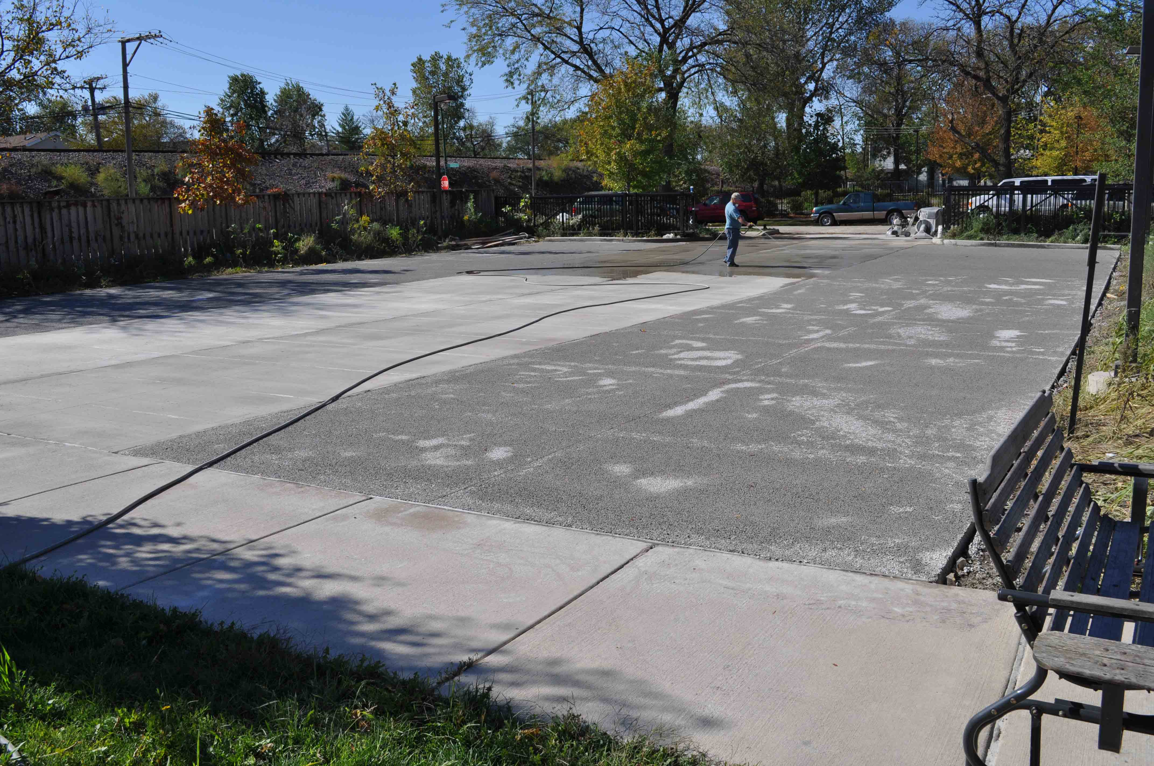
Innovations
Milled Overlay remains permeable
Notes:
Along with fresh-on-fresh overlays, pervious concrete pavement may be milled and overlaid with a wear course that is permeable and well bonded. This milled overlay process is widely accepted as routine service for asphalt pavement. Pervious concrete pavement is resurfaced in a similar way while still remaining permeable.

Slide 27
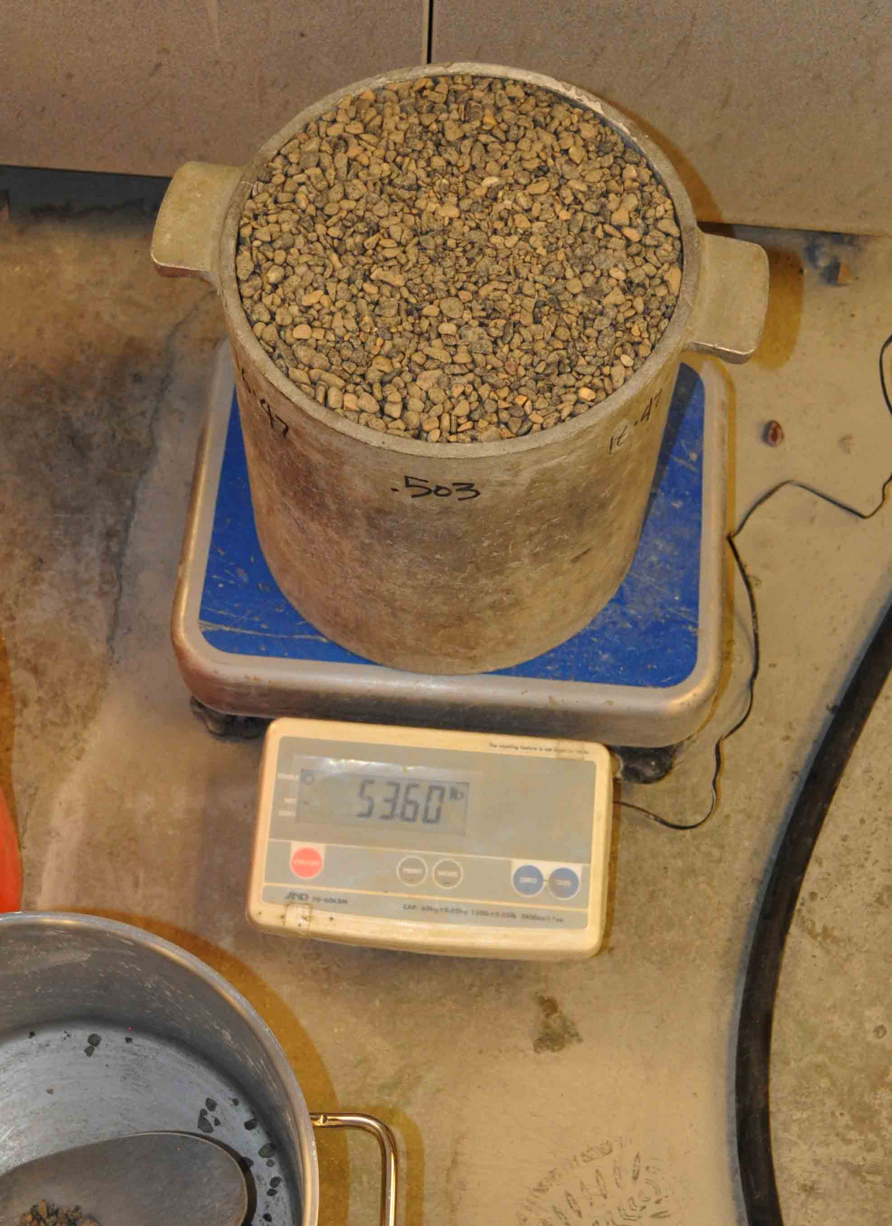
Aggregate properties
ASTM C-29
Specific gravity:
saturated and surface dry
Aggregate solids
Aggregate voids
Notes:
All of these innovations in pervious method brought about even more importance to designing the pervious mixture within the limits of the aggregate properties, mostly its void content. The ASTM C-29 is the first place to look in determining aggregate solids and the subsequent calculation of aggregate voids. The formal procedure for C-29 requires the aggregate specimen to be oven-dry. We find it useful to our pervious objective to run this process with aggregate moisture at SSD condition and apply the known specific gravity of SSD condition. The pervious batching operation will use aggregate that is prepared at SSD, with the unit weight of that material being continually reevaluated as aggregate stock is replenished.

Slide 28
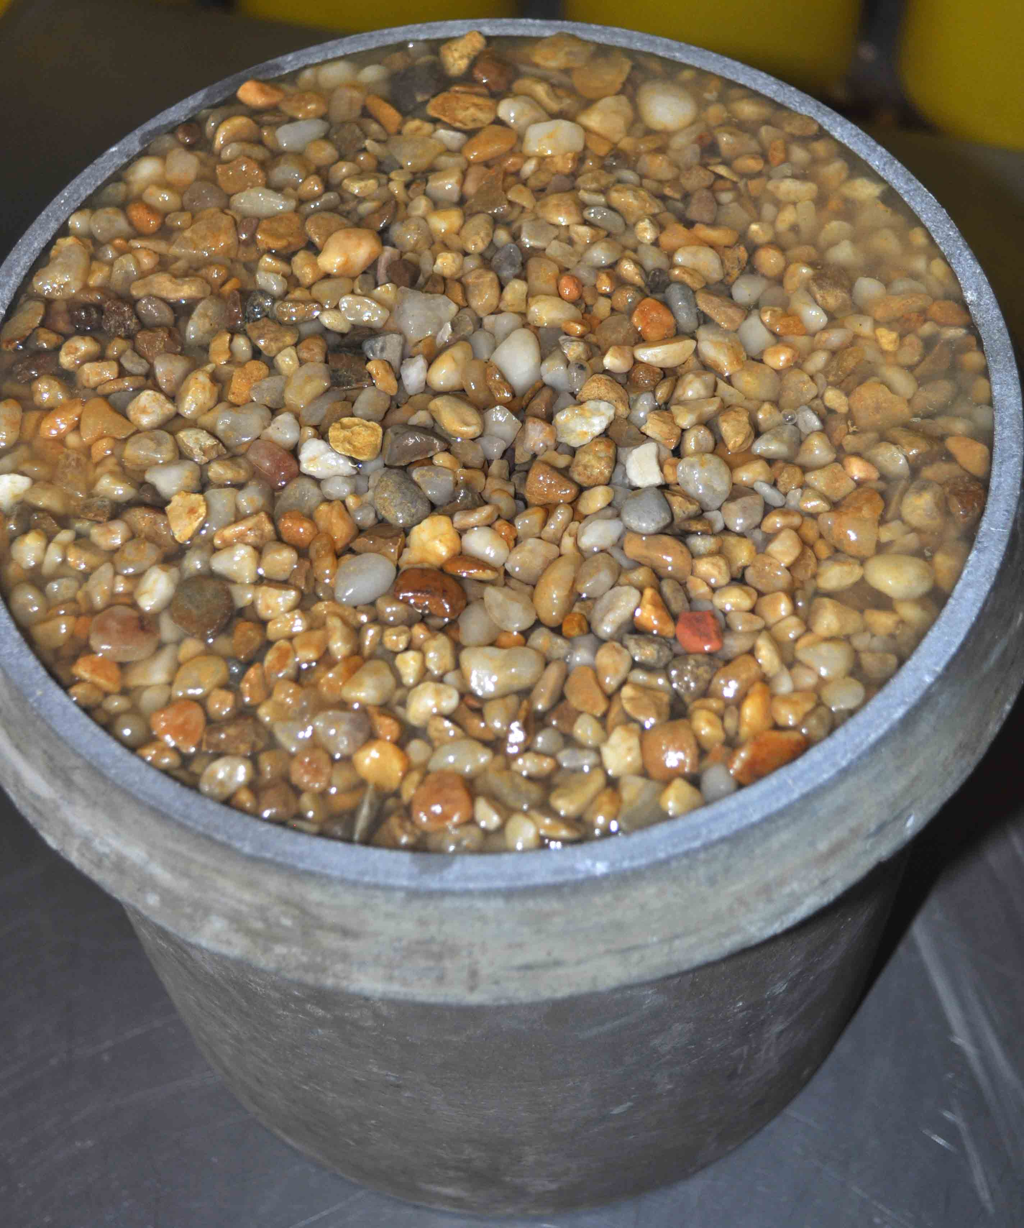
Wet voids
Test at SSD moisture.
Weigh the water that fits in voids.
Verify the c-29 solids calculation.
Define limits of paste volume.
Notes:
We also find it useful to add another step to this process that we call "wet voids". With the specimen and the measure still on the scale, carefully top off the measure with water. The weight of the added water is a more accurate indication of the limits in a given aggregate for the purposes of a pervious concrete mixture proportioning.

Slide 29
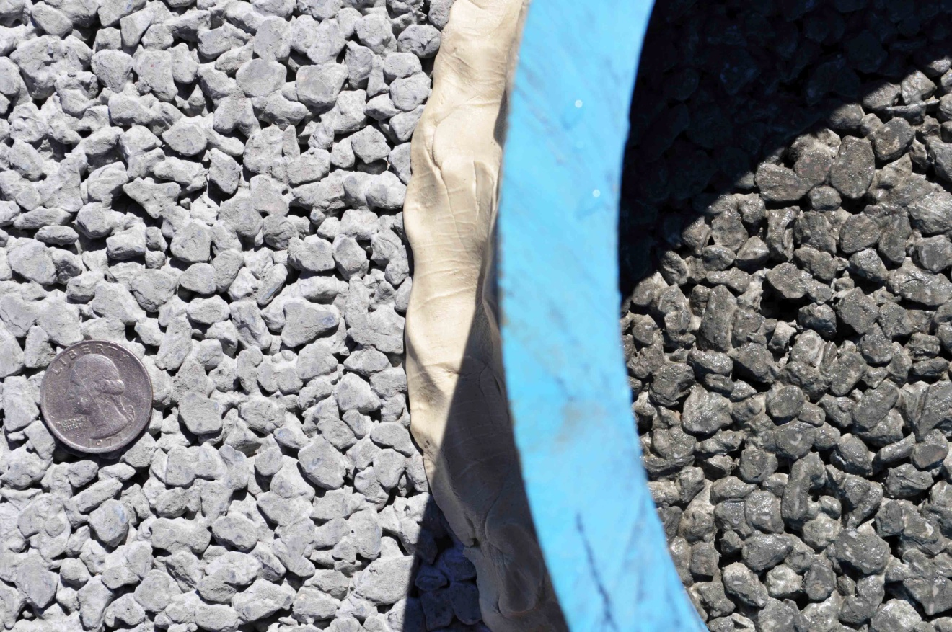
Panable Pervious from troublesome aggregate
Pea gravel @ 31% voids
410 pounds cementitious powder
300 inches per hour infiltration rate
Notes:
During World of Concrete 2014, we demonstrated the advanced finishing technique of the motorized pan float, compared to conventional cross rolling. We found that especially troublesome aggregate required the mixture to be reduced to 410 pounds of cementitious powder in order to maintain infiltration at 300 inches per hour. This troublesome aggregate is not much different than most of the 89 stone and pea gravel that exists in most aggregate bins across the United States. Modern pervious concrete is easily produced from almost any batch plant in this country if the critical limitations are known and observed.

Slide 30
Especially special products
Special
Secret
Essential
Mysterious
Notes:
There is no shortage of people who sell a special product and claim that their special product is essential for your pervious success. I try to offer an unbiased evaluation and description of the products that would add value to your pervious mixture. If this helps, you may want to join our think tank at the annual Bunyan Pervious Roast. Ultimately, you should make your own assessment, based on your own experience with available materials in your own Generic Pervious mixture.

Slide 31
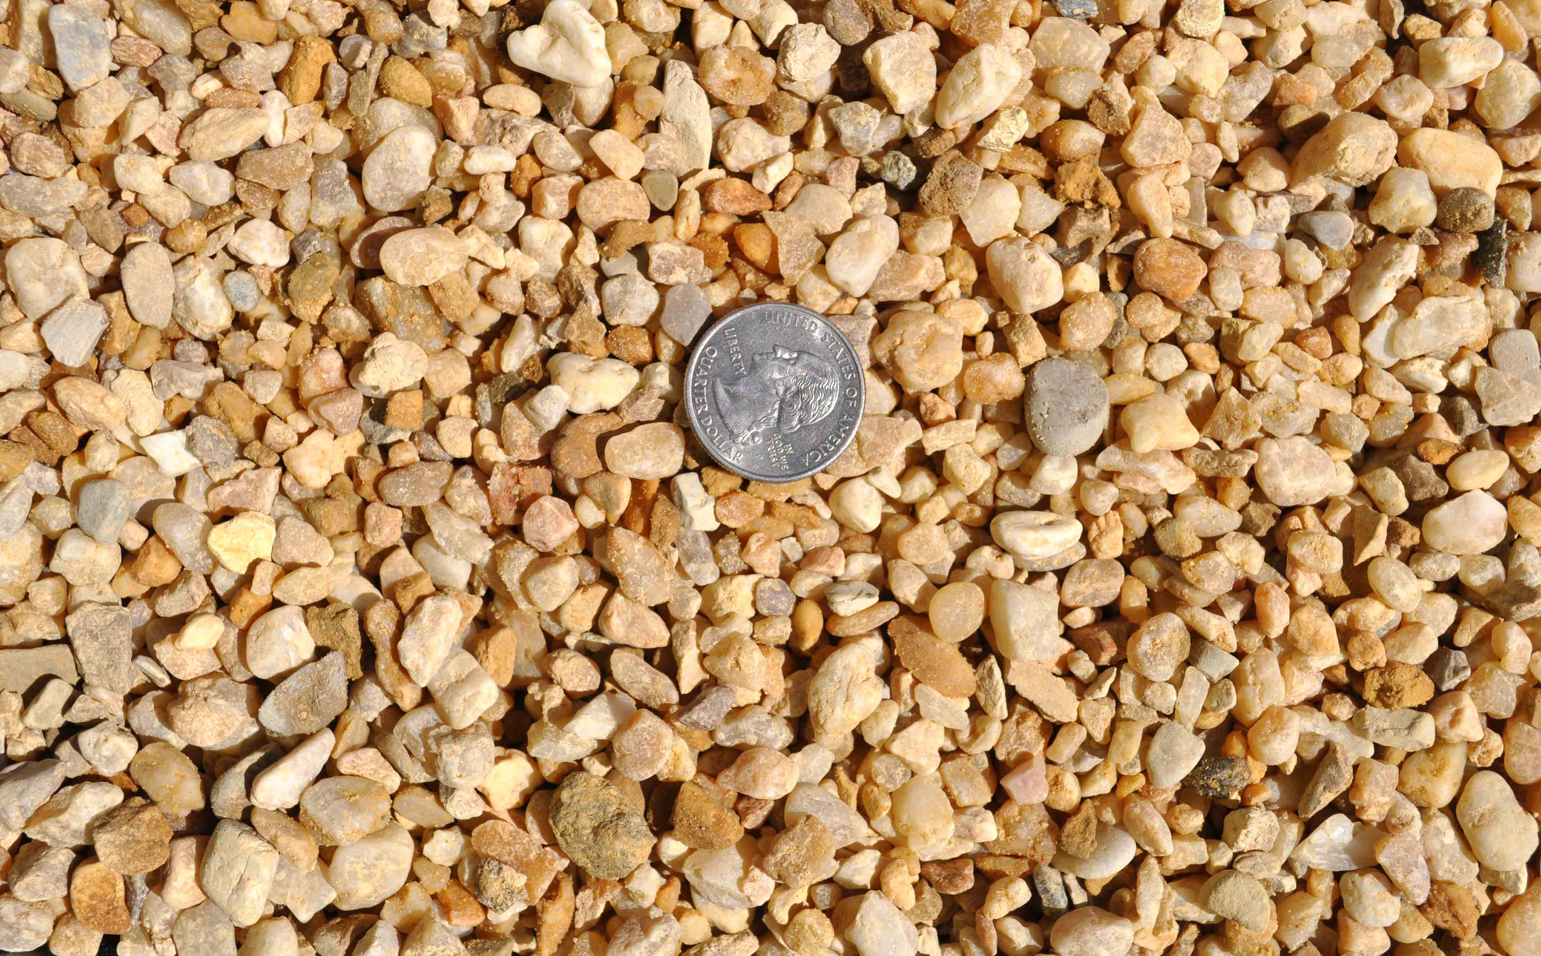
Specialty aggregate
Higher void content
Uniform shapes
Perfect gradation
Smaller sizes
Color
Notes:
Consider carefully the resources available through your local ready mix producer. Their service and their materials will determine most of the unique properties of your pavement. It has become popular to use specialty aggregates if the bin space and special handling will allow. If aggregate products are available with special color, with perfect size and perfect gradation, your pavement products may be dialed in to match any budget. The most interesting pervious pavement products available today are the ones that will resist deicing salts.

Slide 32
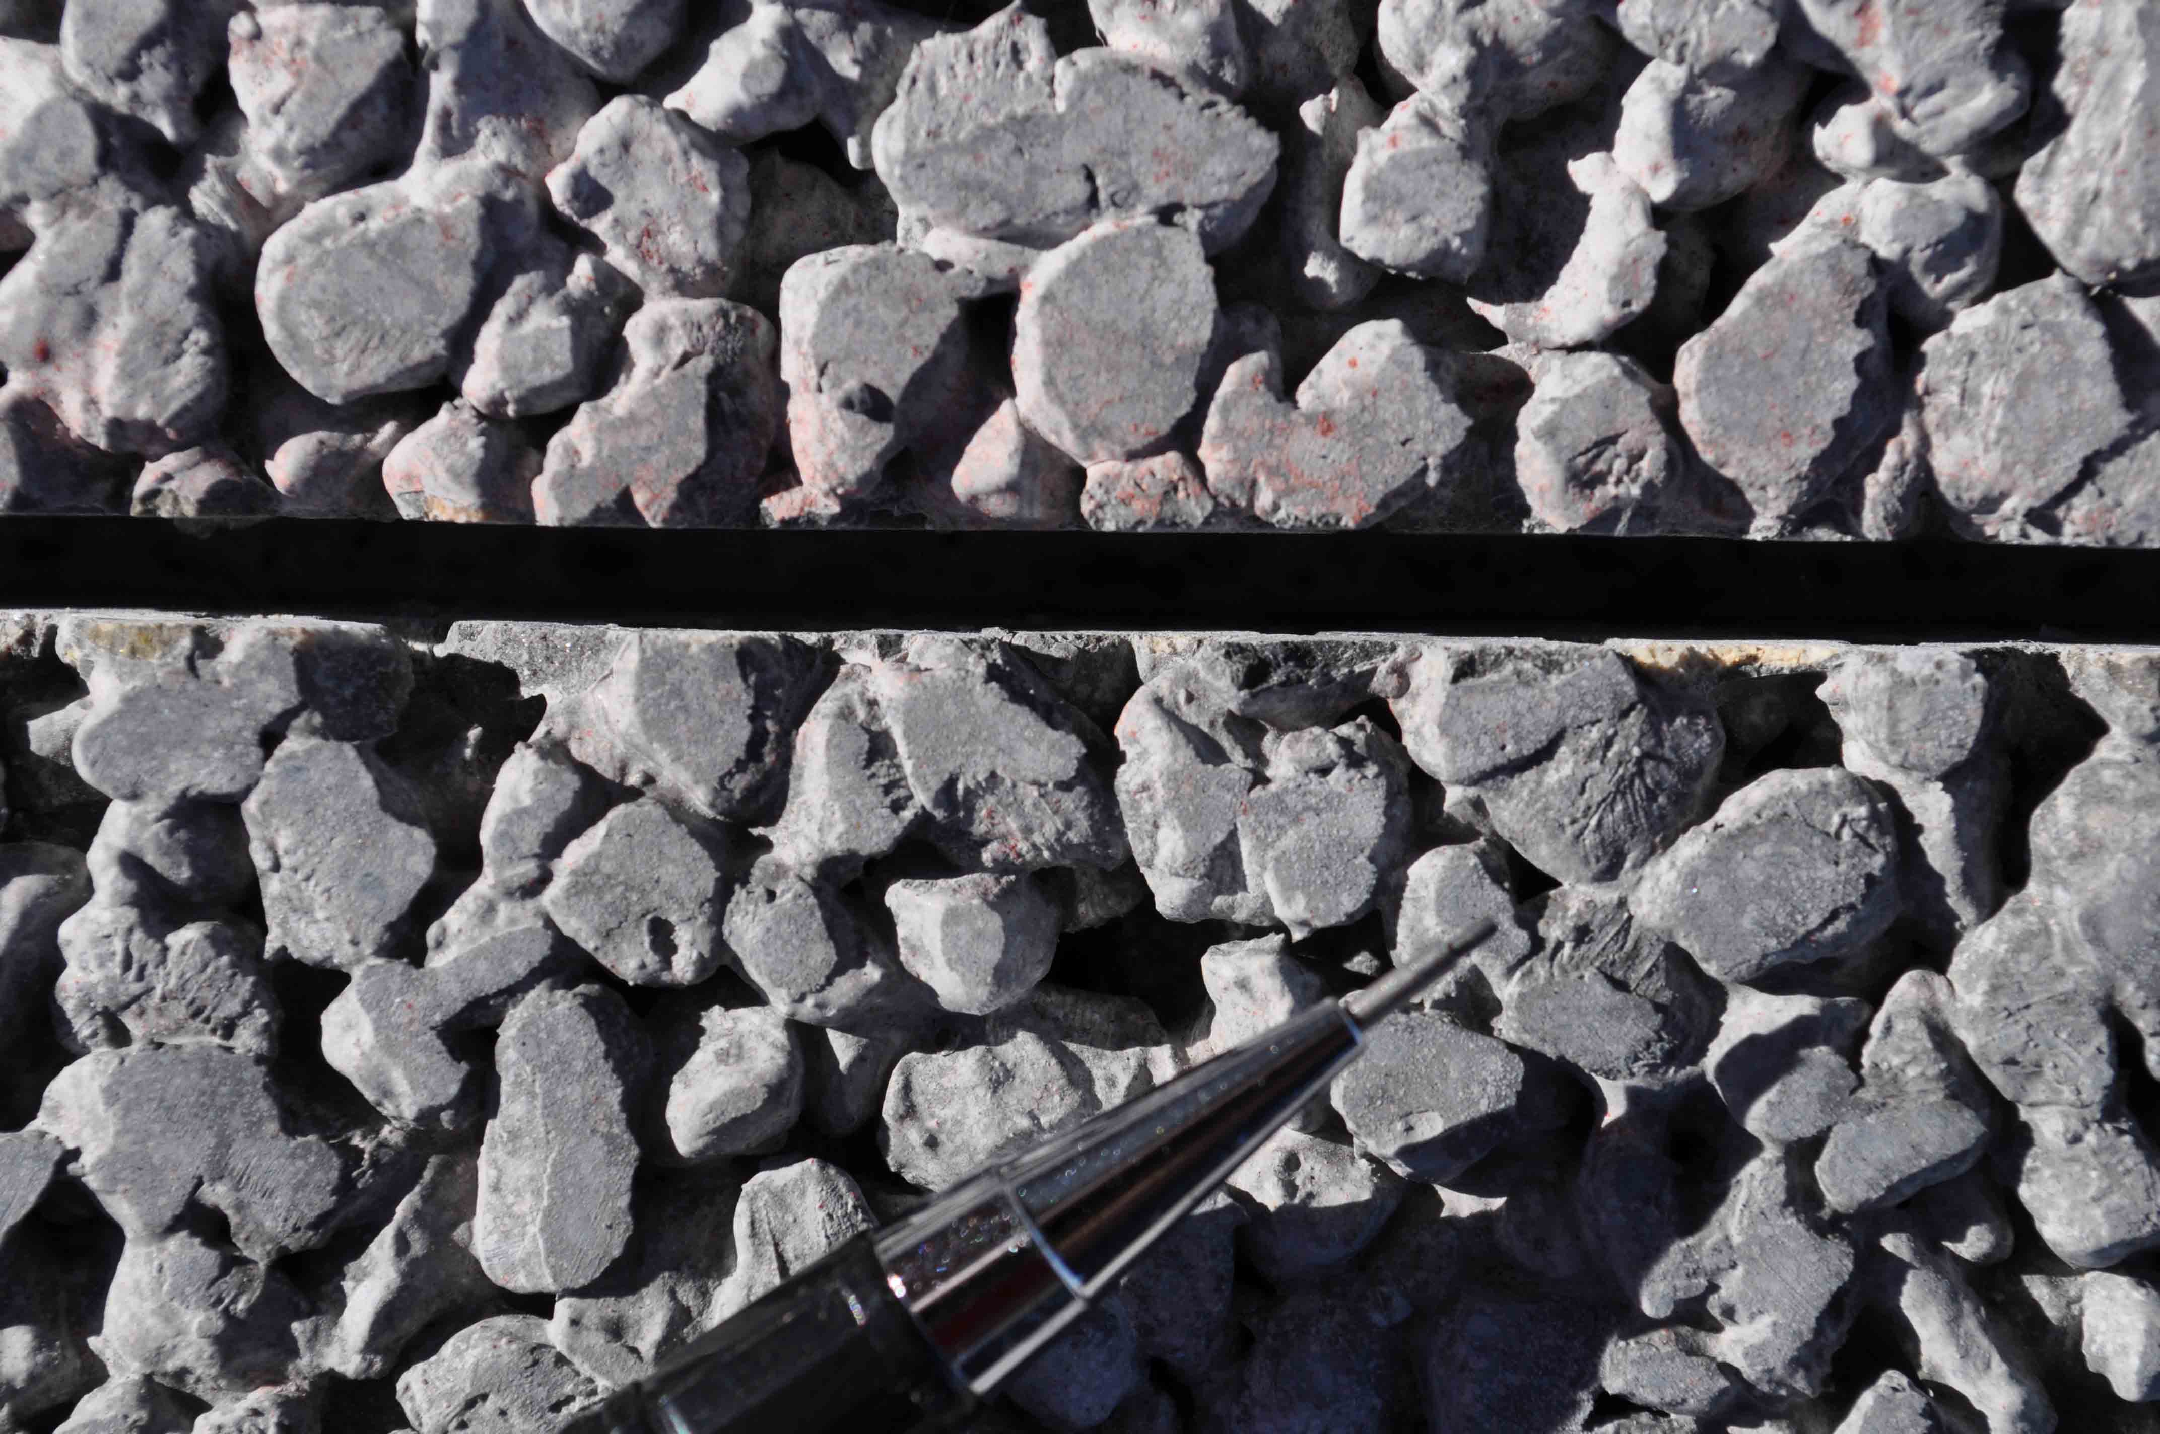
Pretty, smooth
Smaller aggregate for smoother texture
Notes:
The prettiest ones are being made with smaller aggregate for smoother texture.

Slide 33
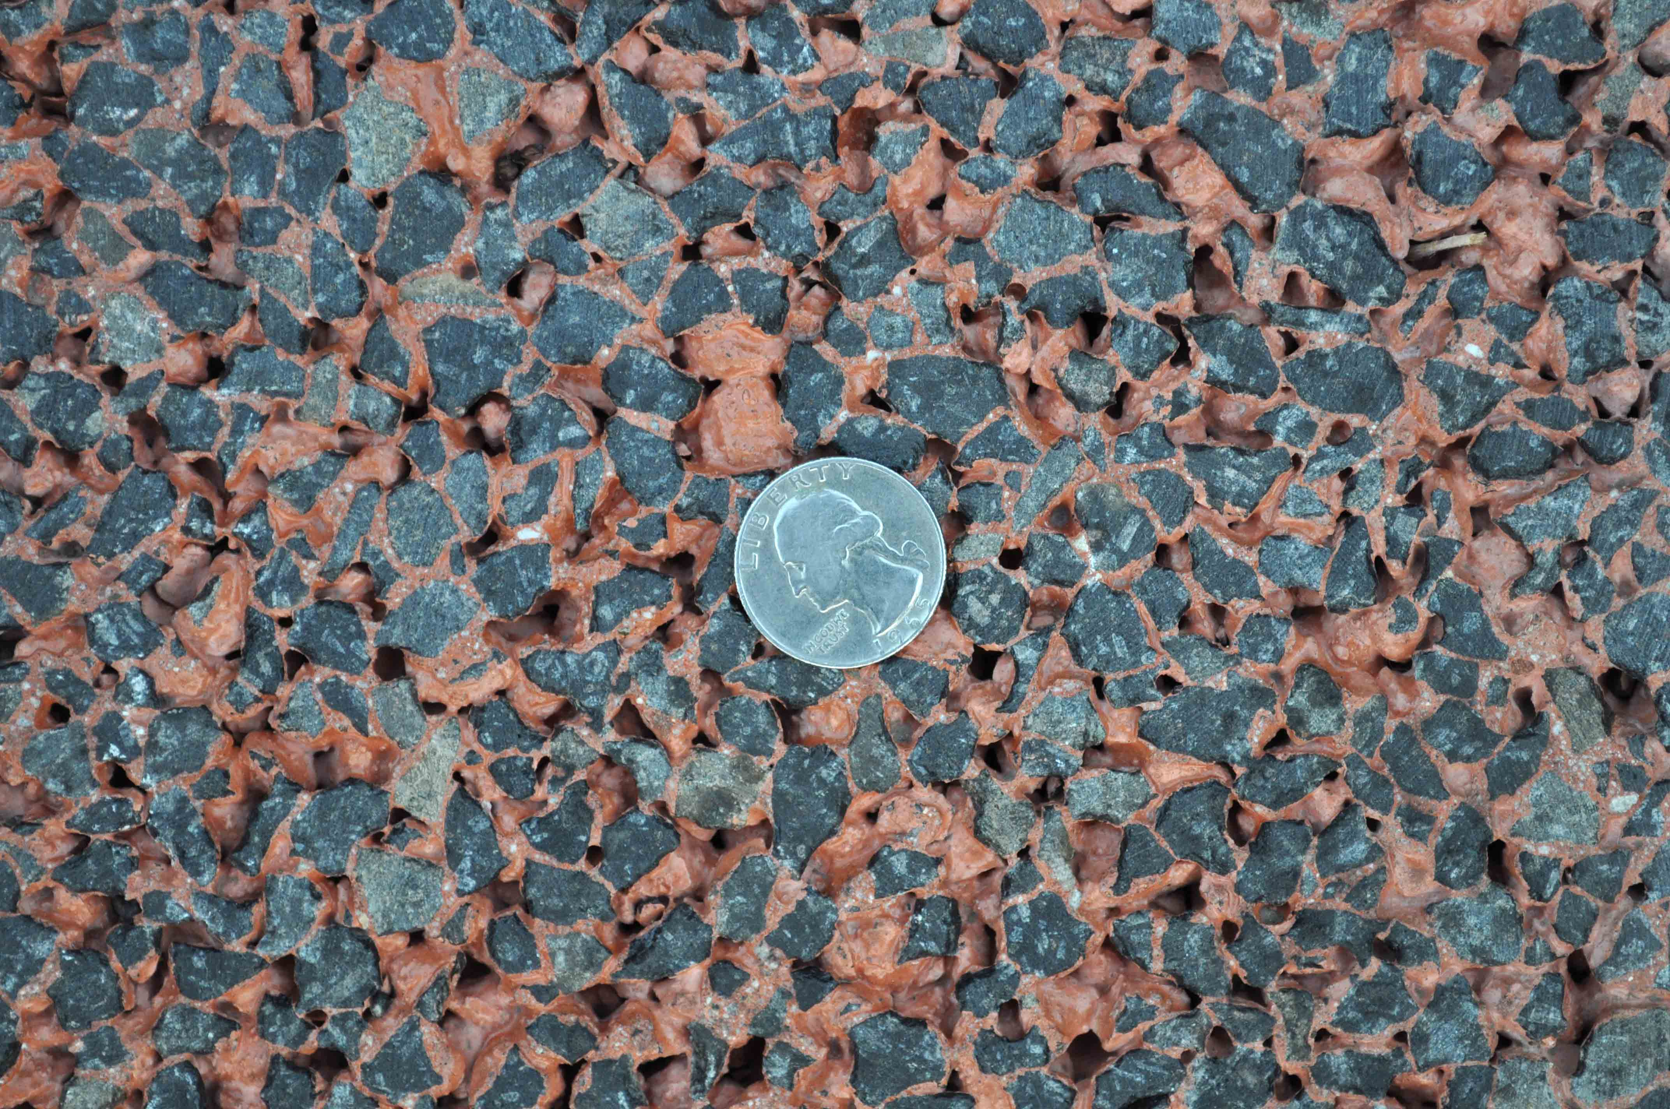
Pretty, colorful
Cut surfaces
Notes:
Cut surfaces can produce a spectacular contrast.

Slide 34
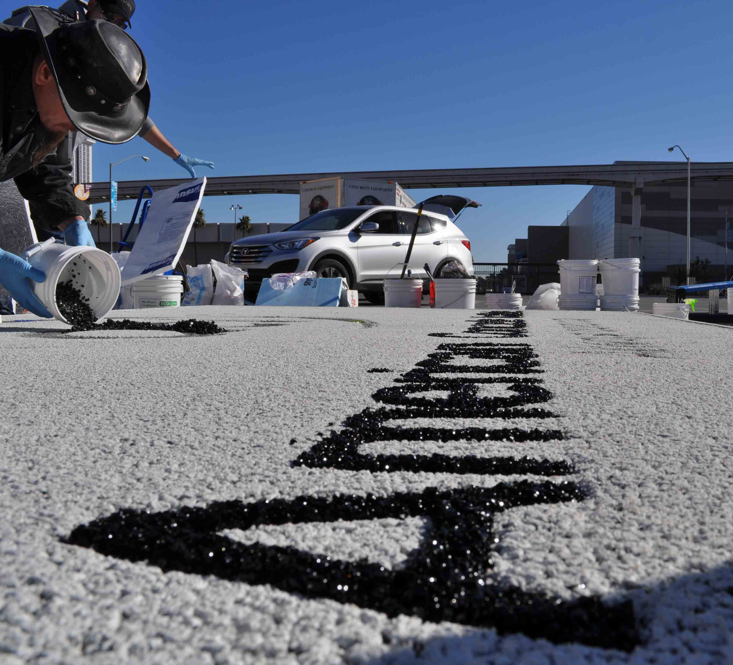
Pretty, erotic
Inlaid glass with poly aspartic binder
Notes:
Glass and rubber may be used with a poly aspartic binder.

Slide 35
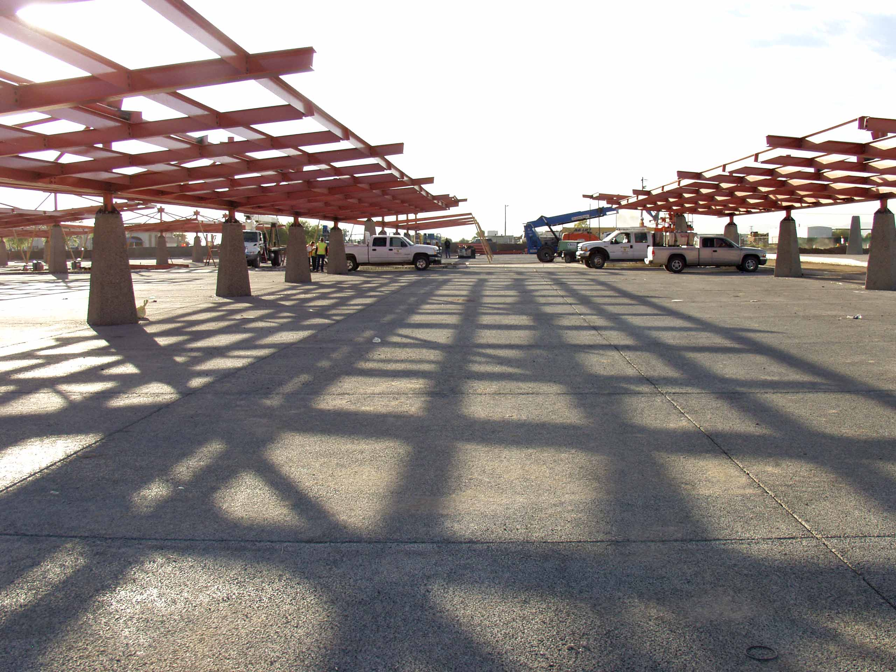
Own it
.
Notes:
The smartest ones are accurately representing this pavement product to those who promote it, to those who build it and to those who own it.

Slide 36
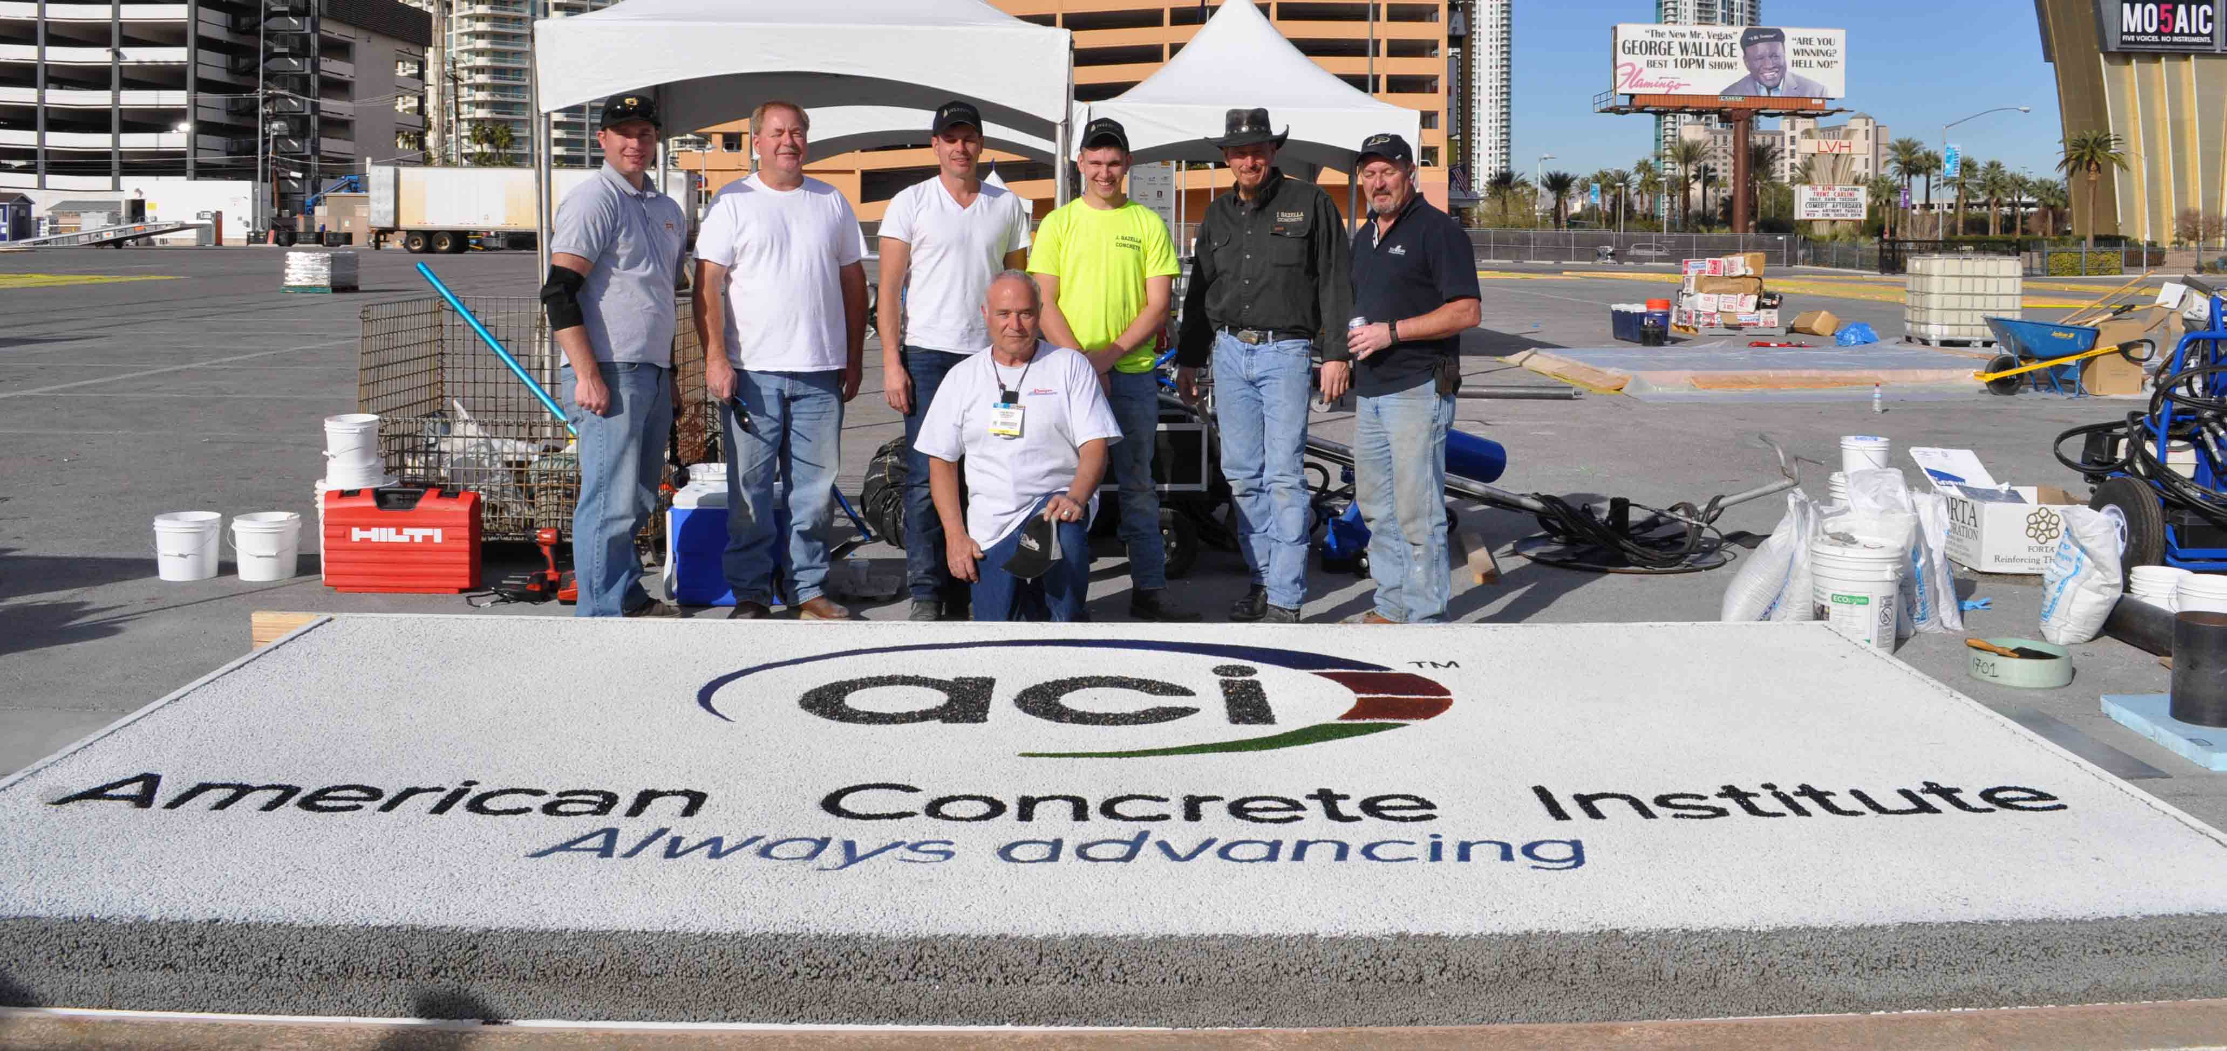
Thanks.
Notes:
Thank you for your time and attention. Please let me help in any way that I can.
Rock on!
David C. Mitchell, PM3

Slide 37
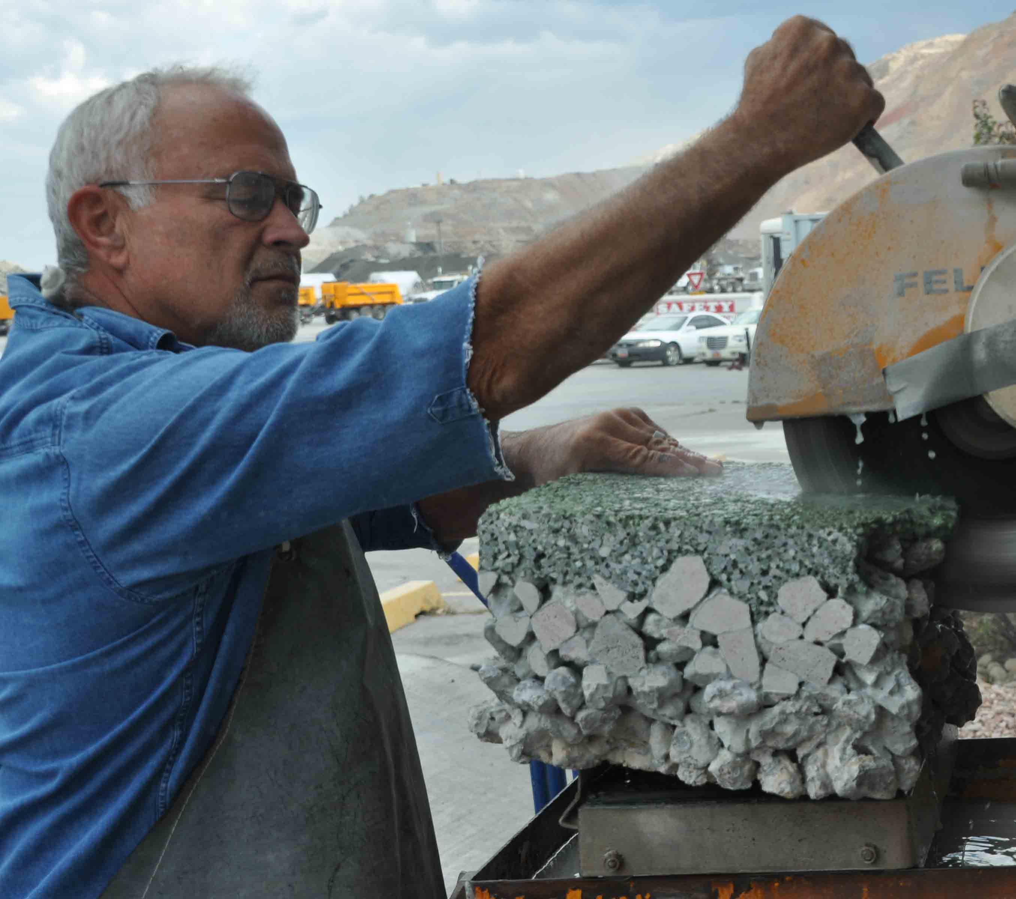
The modulus of gnarly
.

Slide 38
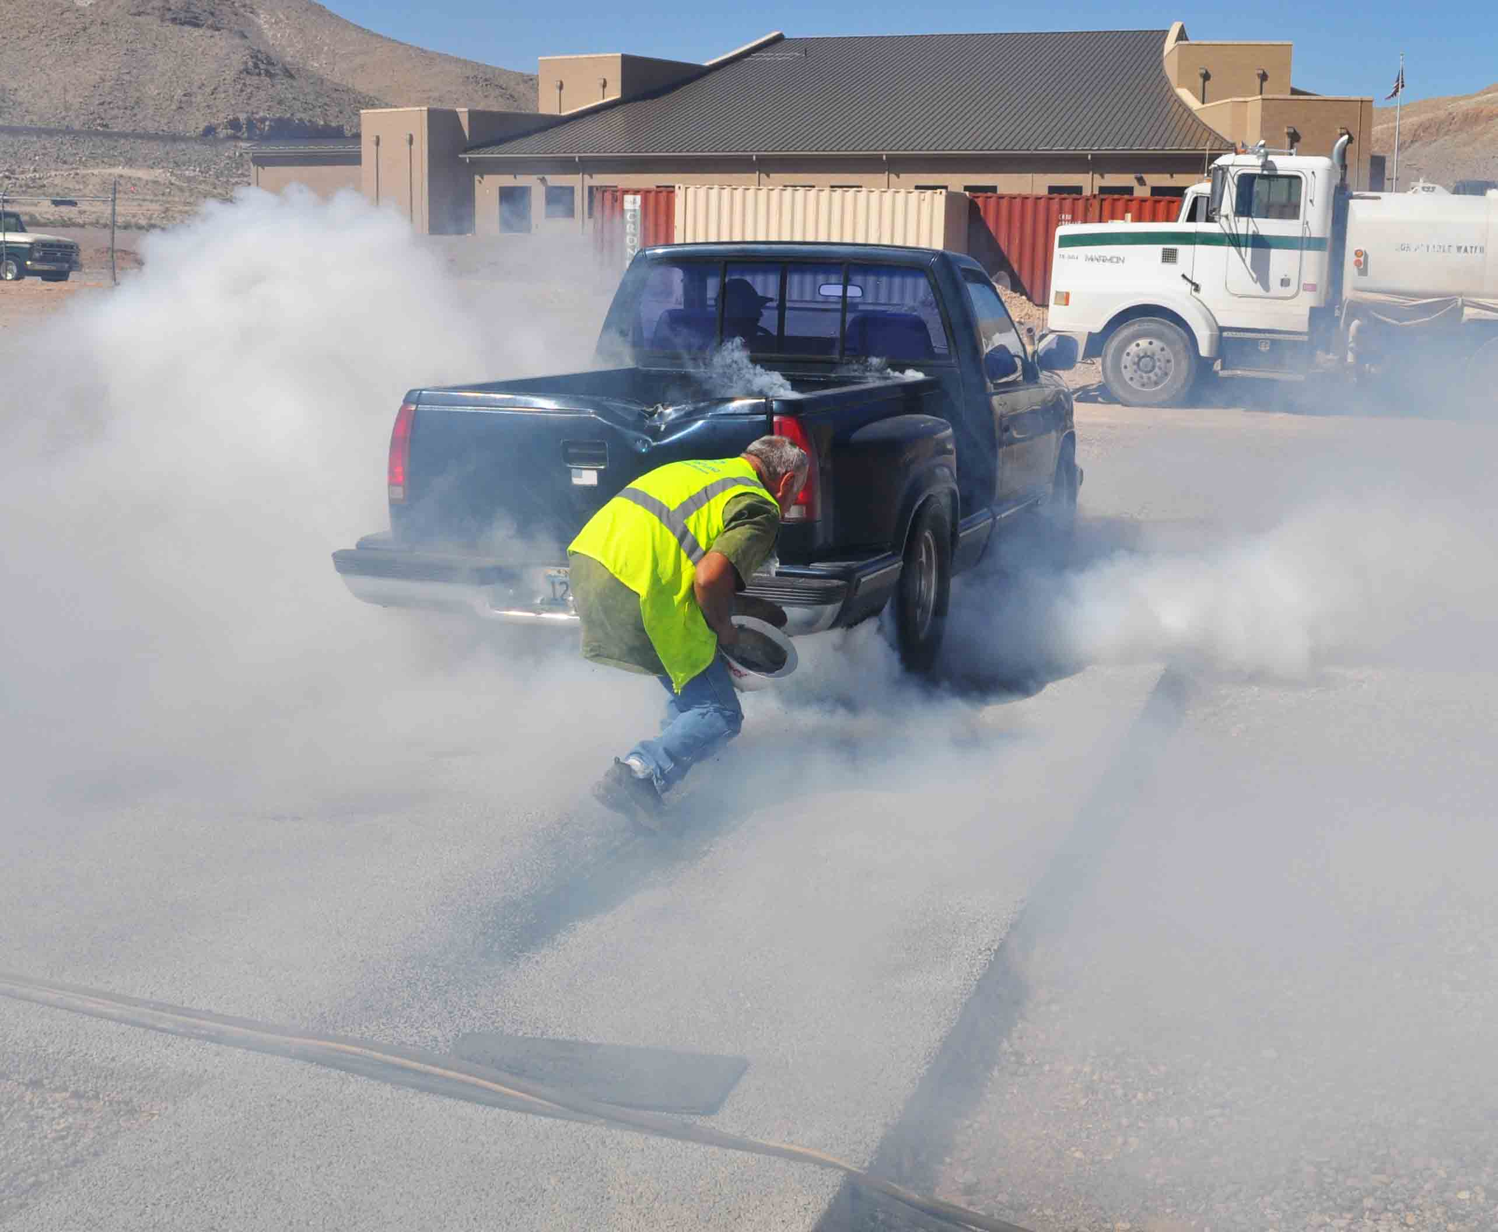
traffic
…for those in a hurry.
Notes:
Vehicles making tight turns and those who enjoy burnouts will find a significant increase in durability.

Slide 39
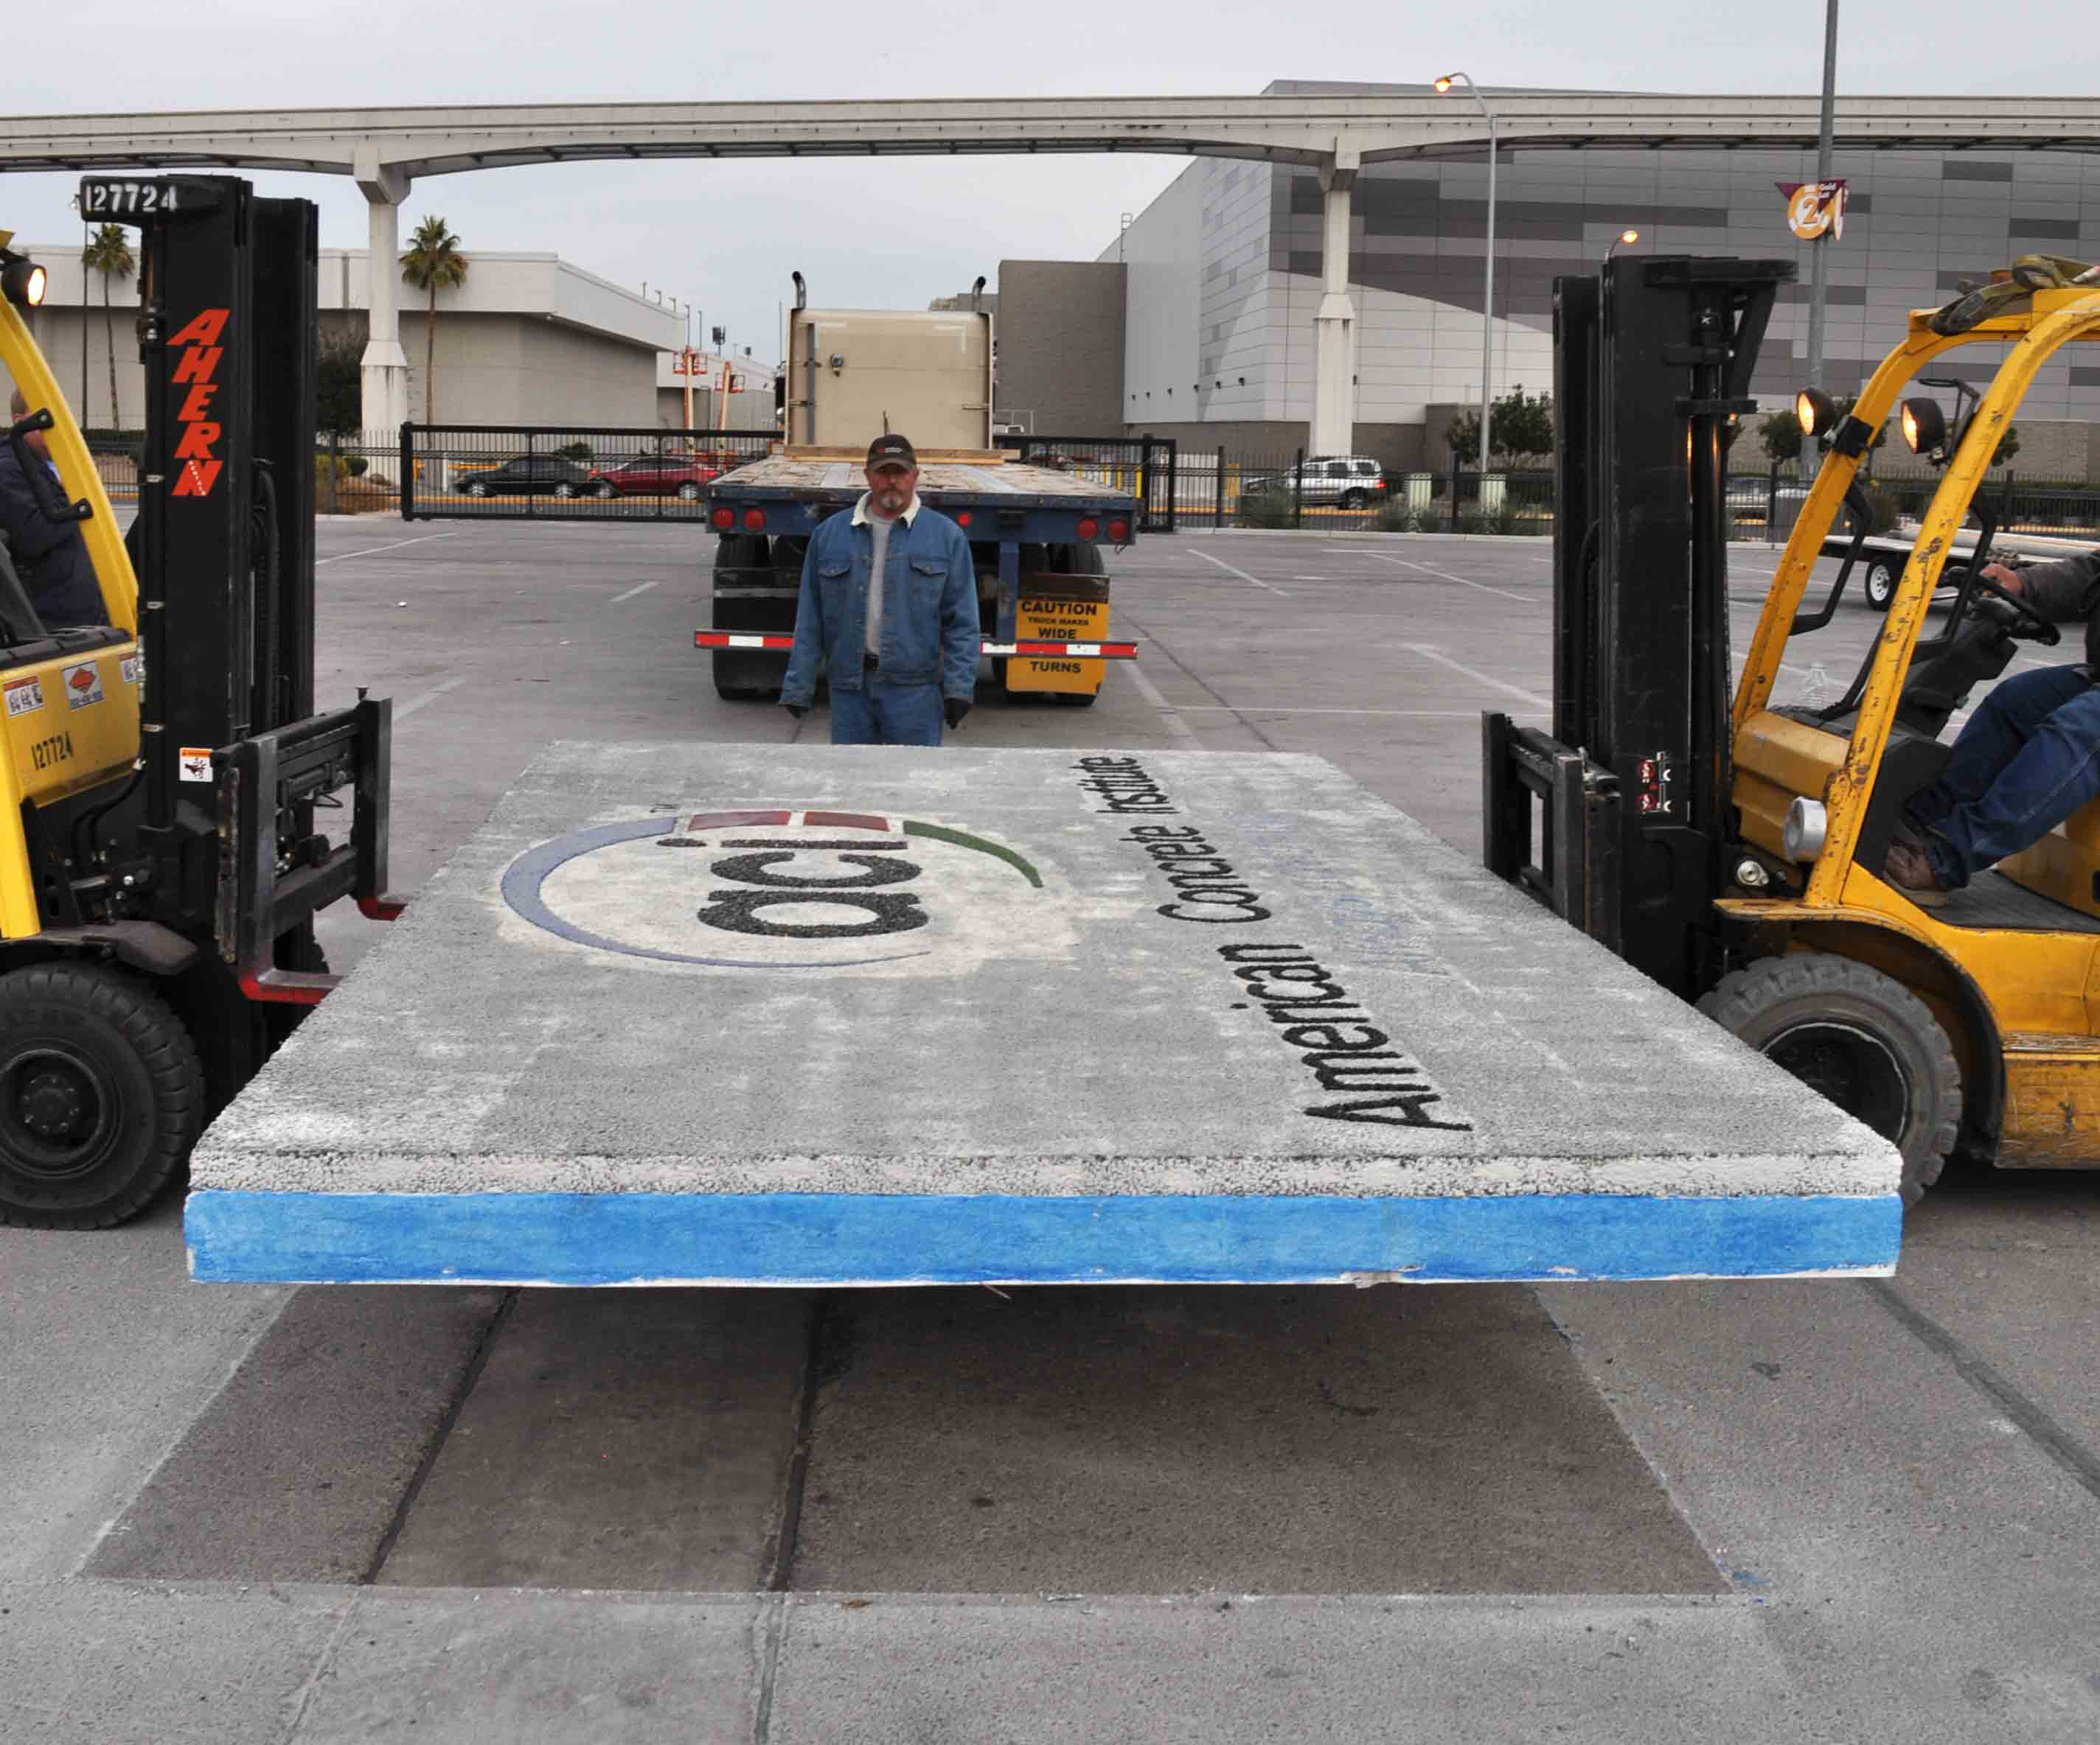
load
…for the extra heavy.
Notes:
Special reinforcement may be used, along with structural fibers.

Slide 40
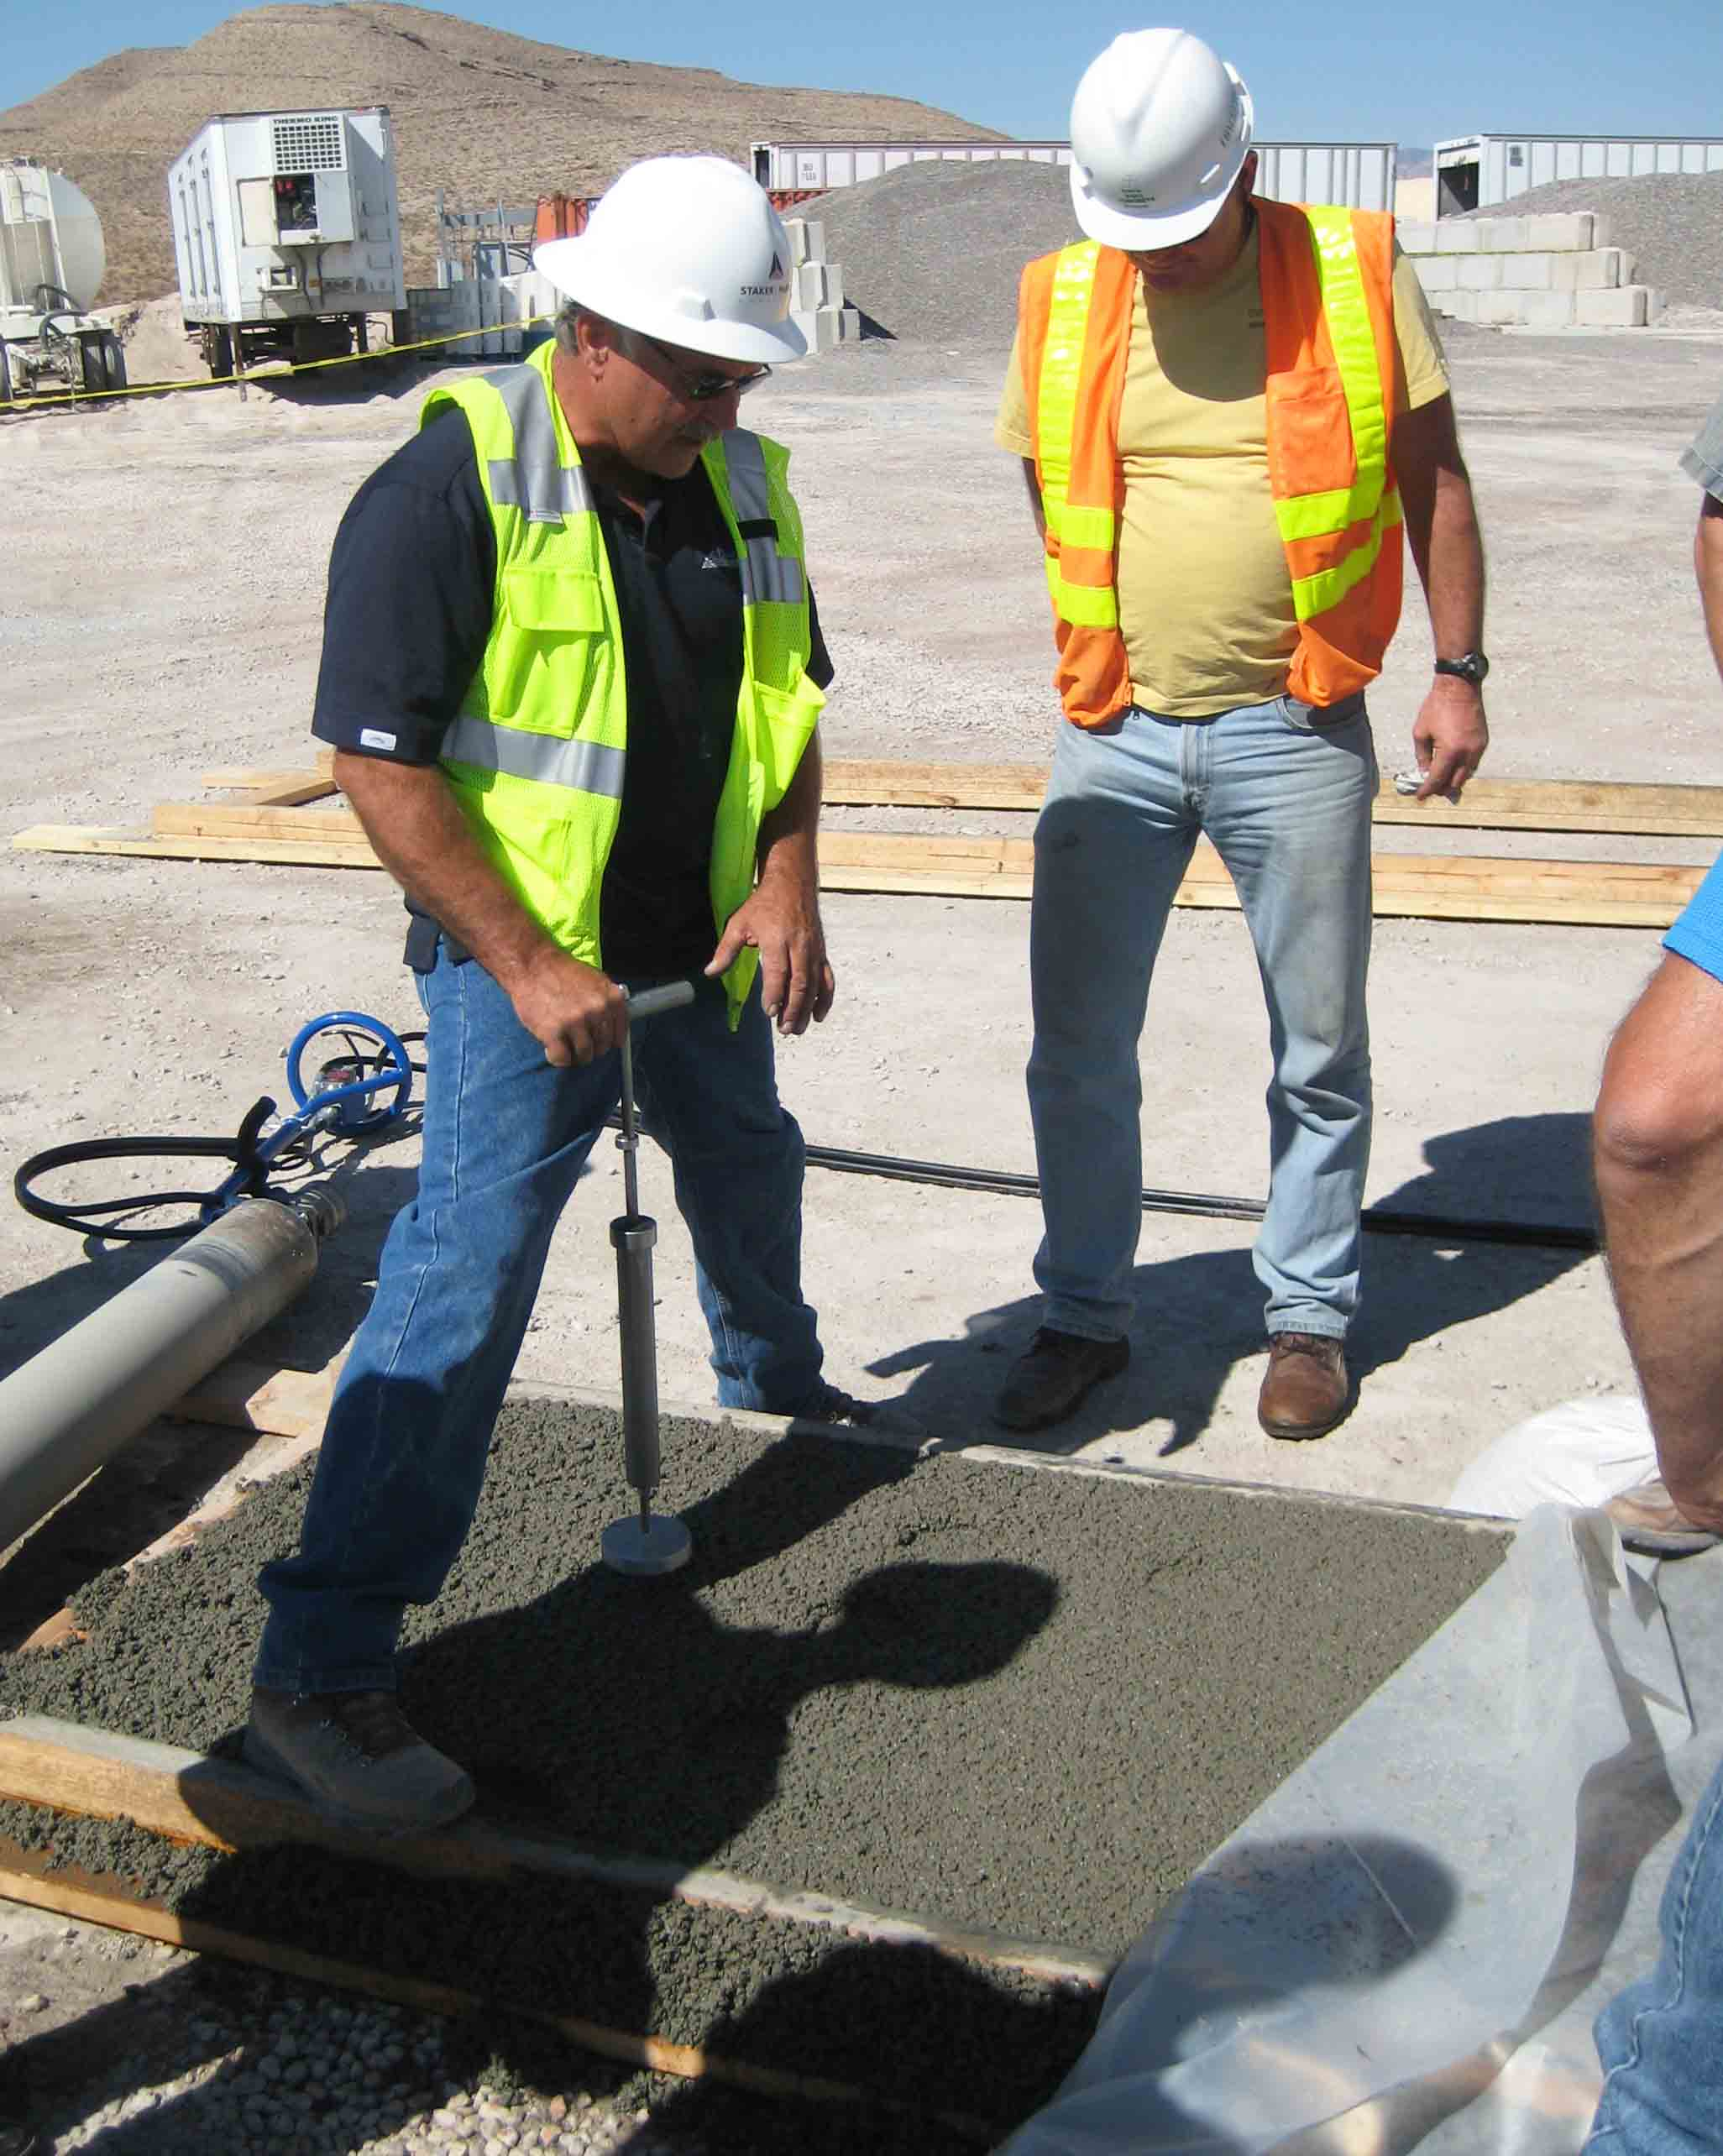
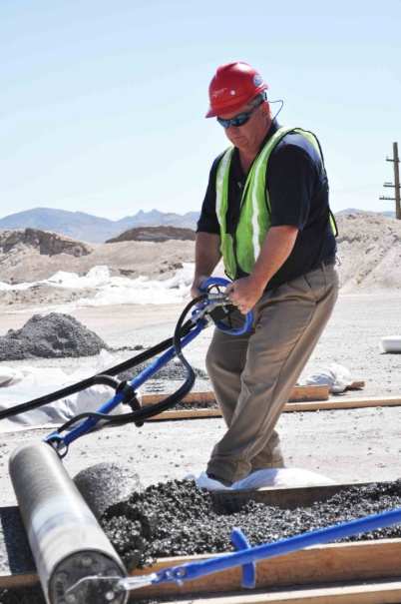
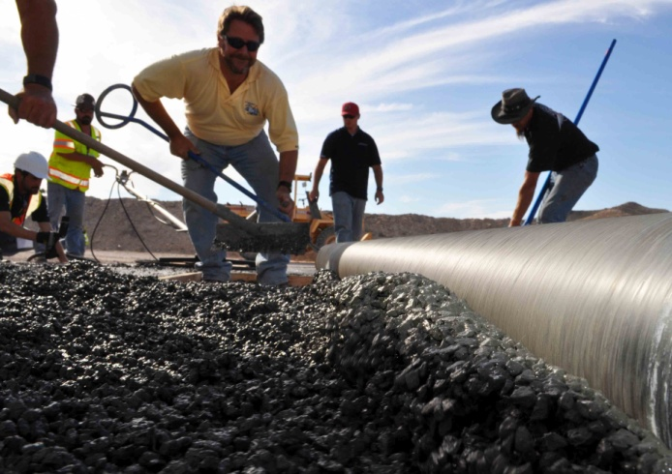
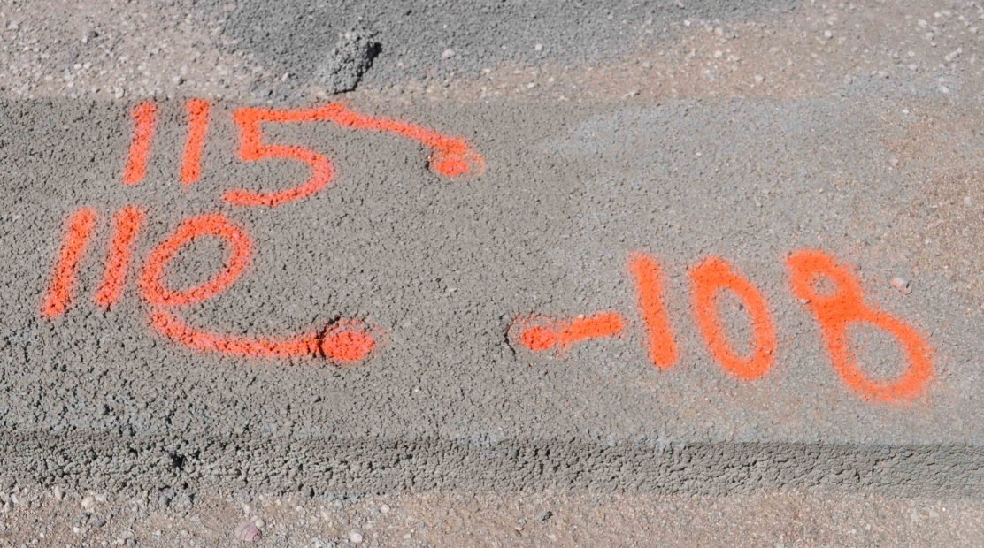
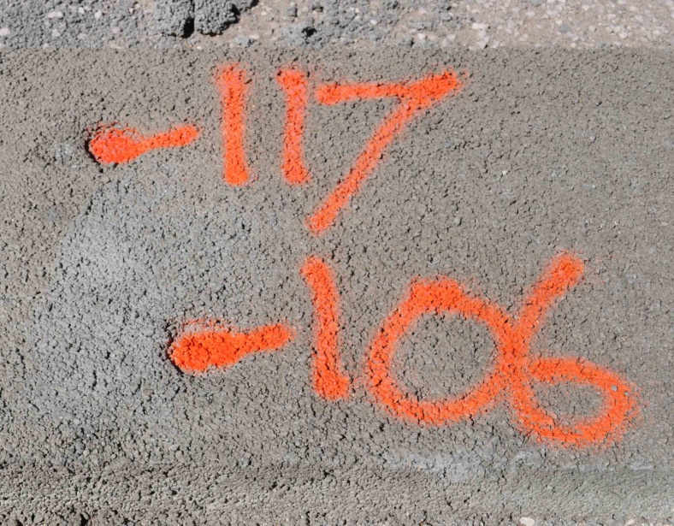
Density
Finding our sweet spot at 20% voids.
Notes:
Voids within the pavement are controlled with the mixture proportion and the equipment being used. Aggregate size and texture will affect the results of a given sized screed diameter. The motorized roller screed diameter as well as the weight, speed and vibration of the pan float must be matched to the mixture. This requires trial placements with all of these components included to allow the owners to evaluate the finish and performance of the test panels. Make sure the owner knows what to expect.

Slide 41
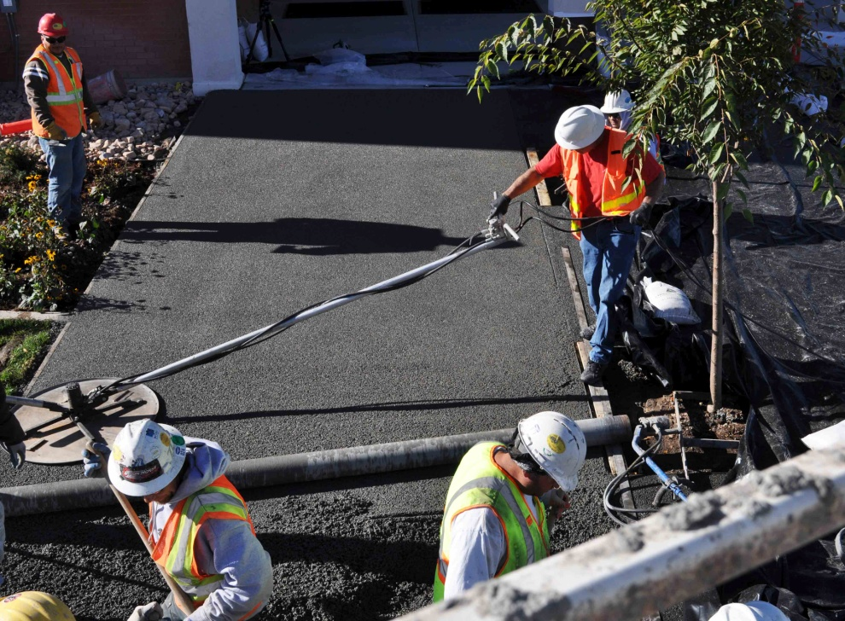
Motorized pan float
Enhanced Surface:
density
uniformity
flatness
Notes:
The motorized pan float has raised the standard for flatness, durability and uniformity. The operator must avoid walking on the surface and some mixtures require very light-weight equipment with very slow pan rotation. The pervious concrete mixture must be matched to the equipment and method which it is used.

Slide 42
infiltration
ASTM C-1701
Choking:
paste overload
mechanical compaction
foreign debris
Targeting infiltration rate
Notes:
Infiltration is monitored during operation and maintenance, based on the infiltration that was recorded when the pavement was new. Locations for this evaluation are recorded on a site map, with logs of information about reduced infiltration and the effectiveness of cleaning services. The owners of pervious are encouraged to be prompt and proactive about cleaning up contamination in the most cost effective way.

Slide 43
strength
ASTM C-496
Splitting tensile
4 X 6
Notes:
Strength testing is not done in pervious materials as a stand-up cylinder, as the results are too erratic. Some believe that the strength has good indication from the splitting tensile from a 4 x 6 cylinder.

Slide 44
abrasion
ASTM C-1747
Three 4 X 4
Notes:
Pervious durability is evaluated in both paste and aggregate with the ASTM C-1747 from three cylinders at 4 x 4. These three samples are tumbled in a LA Abrasion drum without steel balls in the chamber.

Slide 45
Cylinder compaction
ASTM C-1747: 4 X 4
ASTM C-496: 4 X 6
Paste migration, runout
Muffin forms
Muffin press
Notes:
Particular note is taken to form samples which match the density of the unit weight of the particular mixture. Some compaction methods use cylinder molds that compress from both ends. Avoid compaction methods that cause runout, a downward migration in the paste within the sample.

Slide 46
Cylinder compaction
ASTM C-1747: 4 X 4
ASTM C-496: 4 X 6
Paste migration, runout
Muffin forms
Muffin press

Slide 47
abrasion
ASTM C-944
Rotating cutter
Notes:
Surface abrasion may also be evaluated in situ. This cutter leaves a depression that is easily repaired and is often used to indicate areas which need repair.

Slide 48
Hardened density
ASTM C-1754
4” core
Notes:
Hardened density is a good evaluation of average density of cores, cut from pavement in service. The voids indicated in this test are different than the voids indicated in the unit weight, and different than the voids indicated by infiltration. However different these forms of density may appear, the graphs of these are parallel.

Slide 49
Fresh Density
ASTM C-1688
Marshall hammer
Targeted moisture
Notes:
Fresh density is indicated by the unit weight, the only acceptance standard for pervious concrete. However, certain things can be known about the hardened density and infiltration that one could expect from the density shown in ASTM C-1688. Most people are surprised to learn that a small amount of water will cause a much greater increase in the unit weight. The effects of the water result in greater lubricity in the paste which aids the movement of aggregate during compaction.

Slide 50
observations
…beyond informal
Notes:
The quest for pervious excellence continues. We take this product to extremes but we also look for the subtle nuances of this unique product.

Slide 51
slump
Targeting moisture:
wet enough
too wet
Notes:
Targeting moisture is usually visual. The mixture should show a wet and shiny surface tension on the paste and should fall freely from an inverted slump cone. If the sample must be shaken to fall through, it needs more water. Take caution to not exceed the desired moisture which is indicated by runout, downward migration of cement paste shown in the figure on the left. This sample is allowed to stand in the inverted cone for two minutes to note evidence of paste forming at the base of the sample.

Slide 52
joints
Expansion
Sealant
Notes:
Joints and edges must be tooled while the paste is still shining. Tooling done too late is certain to ravel. Joints should be sealed to block incompressible materials from entering the joint.

Slide 53
joints
Tooling
Saw
Notes:
Saw cuts are popular because of a narrow profile and easy timing. Don’t crowd the saw cut too early; usually best at seven days. Some builders will tool every third or fourth joint during placement, then cut the rest after curing.

Slide 54
Silt catchers
Before After
Notes:
Irregular surfaces may be tooled or cut into the surface of the pervious pavement. These stamped impressions are tight in the bottom, and more open in the raised parts of the stamp pattern. This design aids both cleaning and infiltration.

Slide 55
Silt catchers
…during extraction.
Notes:
More impacted clogs require an extraction process that includes intense vacuum force.

Slide 56
Grouted surfaces
Logo art
Toughened
edges
joints
Notes:
Limited amounts of grout may be applied to fresh pervious surfaces for decorative effects and for enhanced durability.

Slide 57
Grouted surfaces
Decorative edges
Repairs
Notes:
Pervious mixtures may be made using other binders such as poly aspartic resin.

Slide 58
Where the rubber meets the road.
Notes:
The most visible part of this pavement is the surface. The pavement must be durable and uniform, as well as flat.

Slide 59
A closer look.
Notes:
The compaction forces applied by the pan will reposition the surface aggregate and form a signature mushroom shape as paste collects on the top aggregate. This process raises immediate concerns of choking the slab and increased importance to mix proportion.

Slide 60
World of Concrete, 2014
Notes:
We did it again this year when ACI commissioned us Roasters to build their new logo into our best pervious for World of Concrete 2014. This slab contains coated rebar and fibers at 5 pounds per cubic yard. This surface was finished with a motorized pan and steel trowel.

Slide 61
World of Concrete, 2014
ACI logo slab project
Notes:
Then the logo artwas stamped and inlaid with glass color. All of the colors use a transparent binder called poly aspartic, with all of the colors are made with glass aggregates. It's so tough we wanted to take it home for durability examination.

Slide 62
Target 300 inches / hour
Notes:
We should target a finished infiltration rate of at least 300 inches/hr. as we observe the effects of the motorized pan, during trial batches of a particular mixture. This is easily maintained even with the careful use of surface grout for decorative features or for additional durability at edges and joints.

Slide 63
Match equipment to mixture.
Notes:
The critical objective in conducting trial batches is to evaluate the compatibility of the mixture, in relation to the method, tools, manpower and logistic resources to successfully build the pavement. Most well proportioned pervious mixtures using normal sized aggregate will easily tolerate a typical, engine driven trowel machine, fitted with a typical pan float.

Slide 64
A tighter finish is easier to maintain.
Notes:
Our ultimate objective is to make tougher pavement that drains well. We must build this pavement to remain tough and well drained throughout the decades of service life that are expected of pervious concrete storm water systems. Our objective is to overcome the historic errors of raveling and clogging. The motorized pan advances these objectives by certain obvious effects on flatness and surface uniformity in connecting the surface aggregate. The pan finished surface tighter surface allows less debris to enter the surface and is easier to clean.

Slide 65
Flat, uniform surfaces.
Notes:
Low spots are carefully seeded with fresh concrete. These filled areas and other high spots are effectively chewed down into proper elevation. Any hand work that follows the pan is done with a steel trowel.

Slide 66
Thanks.

